Slide 1
Azure Migrate
March 2022

Slide 2
Agenda
01
02
03
04
05
06
07
08
09
10
11
12
13
Azure Migrate overview
Discover, assess, & migrate servers to Azure
Discover servers
Discover applications and dependencies
Assess servers for migration
Assess SQL servers
Migrate servers to Azure
Agentless VMware migrations
Agentless Hyper-V migrations
Agent-based migrations
Migration concepts
Private Link support
App Containerization

Slide 3
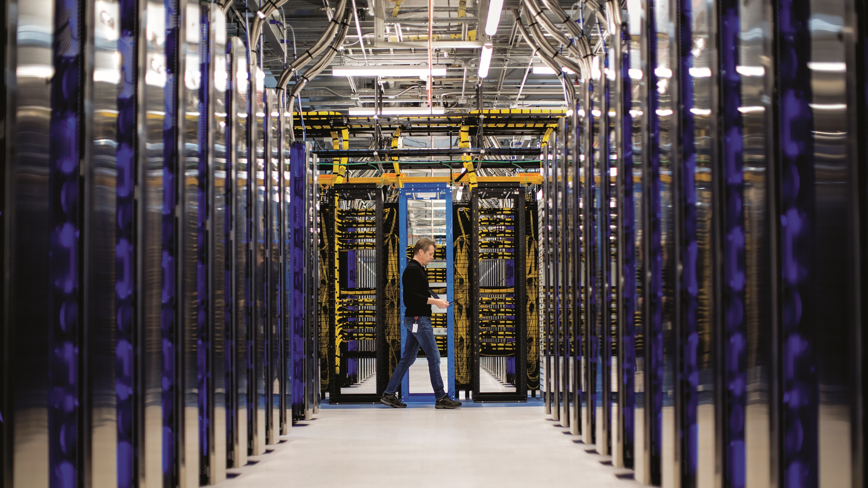
The question is no longer “if or when”, it’s “how”
Digital transformation is an economic imperative
90% of organizations already use the cloud
The cloud is the safest place for your business
Benefits of the cloud are proven
Notes:
Companies are being forced to transform themselves. Those that make the transformation survive.
Let me ask you a question. How many purchases did you make at Amazon in the last month? And how many at a brick and mortar retailer? When you were walking to that brick and mortar retailer, how many businesses did you notice that were closed, or had been replaced by someone new?
Digital Transformation is an economic imperative.
Music services like Spotify have replaced the records stores of yore. Even those that still love vinyl are much more likely to shop for their LPs online.
Movies? Netflix replaced the local Blockbuster, and you’re much more likely to stream your favorite action movie than wait for a DVD to be delivered.
To stand in front of you today, I reserved and paid for my flight and hotel online. At the airport, I used an app to order an Uber, which brought me to the hotel. The concierge handed me a package; the new phone charger I ordered in Seattle for delivery here. I have a reservation for dinner this evening I made using OpenTable.
The business I frequent have all embraced digital. I’d bet it the same for most of you.

Slide 4
Cloud Adoption Framework
Define Strategy
Plan
Ready
Adopt
1
3
Gather data and analyze assets and workloads
7
Deploy an aligned landing zone
8
Innovate in the cloud
Document the business strategy
2
Evaluate business justification
4
Plan asset migration
Govern
Manage
5
Align governance requirements to adoption plan
6
Define operational needs and business commitments
Notes:
When you are talking to customers about migrating one of the first things, I think you will all mention is the Cloud Adoption Framework and how it can assist with the customers’ migration project.
If we look at the Plan section, it highlights the need to gather information about the customer’s environment. And this is something that’s massively important and where Azure Migrate can help.

Slide 5
What is a workload?

Slide 6

Azure Migrate – Cloud Adoption Strategies
MIGRATE / REHOST
OPTIMIZE / REFACTOR
MODERNIZE / REBUILD
INNOVATE / REARCHITECT
Build the Foundation and Achieve Quick Wins
Optimize IT Cost and Enable New Capabilities
Modernization of Apps and Data Platforms
Digital Transformation and Business Innovation
Hardware savings on server, storage and networking equipment
Software savings – Cost out of unused 3rd party Software licenses
Reduced Maintenance costs – Due to vendor contract reduction
DC Facility savings – Free cash flow from reduced Datacenter facilities and energy
Higher SLA and uptime – 99.9% minimum
DR as a Service – Cost effective and high-speed DR
Administration Efficiency with automated management and insights
Reduced Cyber Risk – Multi-layered security controls and threat intelligence
Compute Optimization with auto scalability
Application Optimization leveraging PaaS services with minimal change
Network Optimization through new network delivery & consumption models
Database optimization with Managed Instances and Cloud Database
Cloud Automation – Streamline processes using predefined and automated configurations
Cloud-native capabilities that drive innovation and reduced time-to-market
Scale digital initiatives with continuous innovation
Business agility – React to business demands faster
Digital Talent: Cloud-first culture
Highly Productive Development - Fully Managed Development Platform
Build Intelligent apps – Fast access to advanced technologies (AI, Blockchain, IoT, HPC)
Cloud-based Data and Analytics to improve customer experience
DevOps capabilities for continuous and faster software delivery
Up-to
Triple-Digit ROI (Business)
Up-to 50% Cost Savings
BENEFIT
Up-to
20%-30% Cost Savings
COST

Slide 7
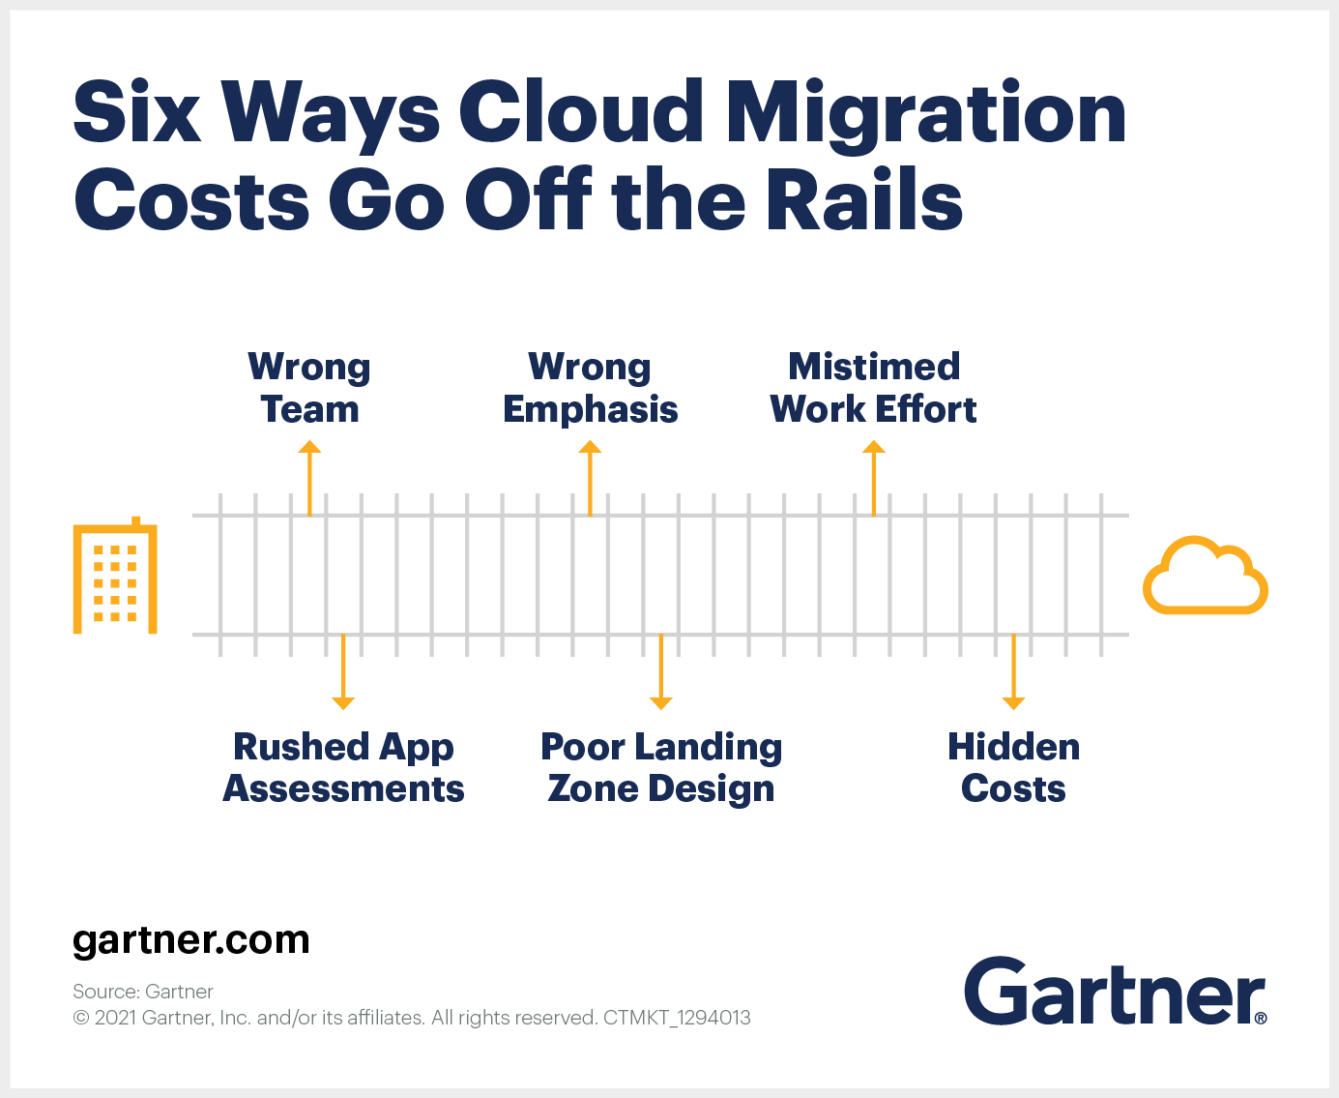
Discovery is key
https://www.gartner.com/smarterwithgartner/6-ways-cloud-migration-costs-go-off-the-rails/
Notes:
Discovery is key.
Gartner released an article last week talking about how cloud migration clouds go wrong and one of those reasons was because the assessment, discovery piece was rushed.
Failing to fully assess the workloads to be migrated is a common mistake, resulting in incomplete specification of migration requirements and downstream scope creep.
I’ve seen that happen unfortunately with customers and I’m sure you have as well.

Slide 8

Picking a tool
Consider how it gathers data
Consider how it stores data
Consider pricing
Notes:
How when you talk about migration and discovery to a customer the temptation might be to actually just throw Azure Migrate into the customers environment but you need to understand if it’s the right tool for the customer.

Slide 9
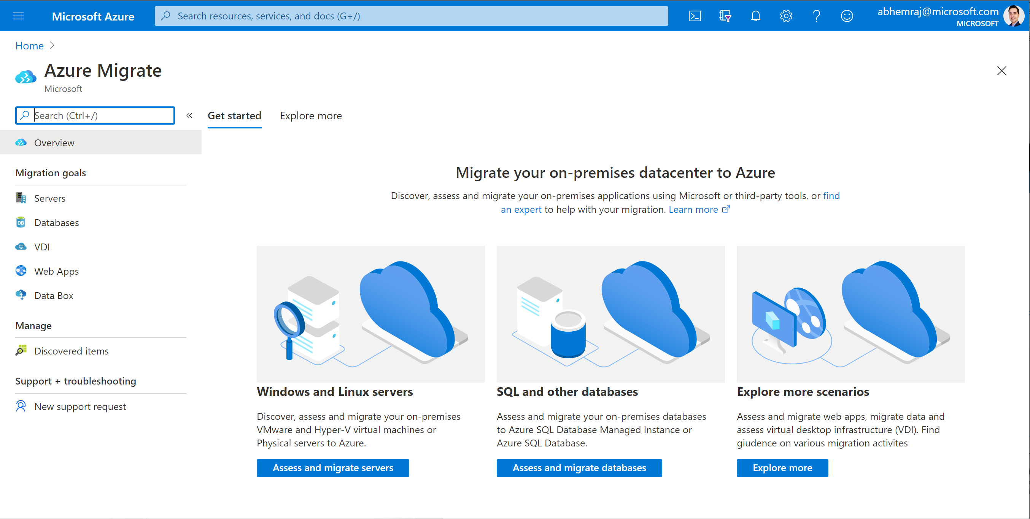
Azure Migrate
A central hub of tools for your datacenter cloud migration
Multiple scenarios
Coverage for servers (Windows/Linux), databases, VDI, web apps, and large volumes of data
Migration targets include Azure VMs, AVS, App Service and Azure SQL
Notes:
In the past, cloud migration was overwhelming with disconnected tools in different places. That's why Microsoft introduced Azure Migrate to bring everything together and simplify cloud migration. With one centralized migration service, you can discover and assess your datacenter, and then migrate workloads to Azure.

Slide 10
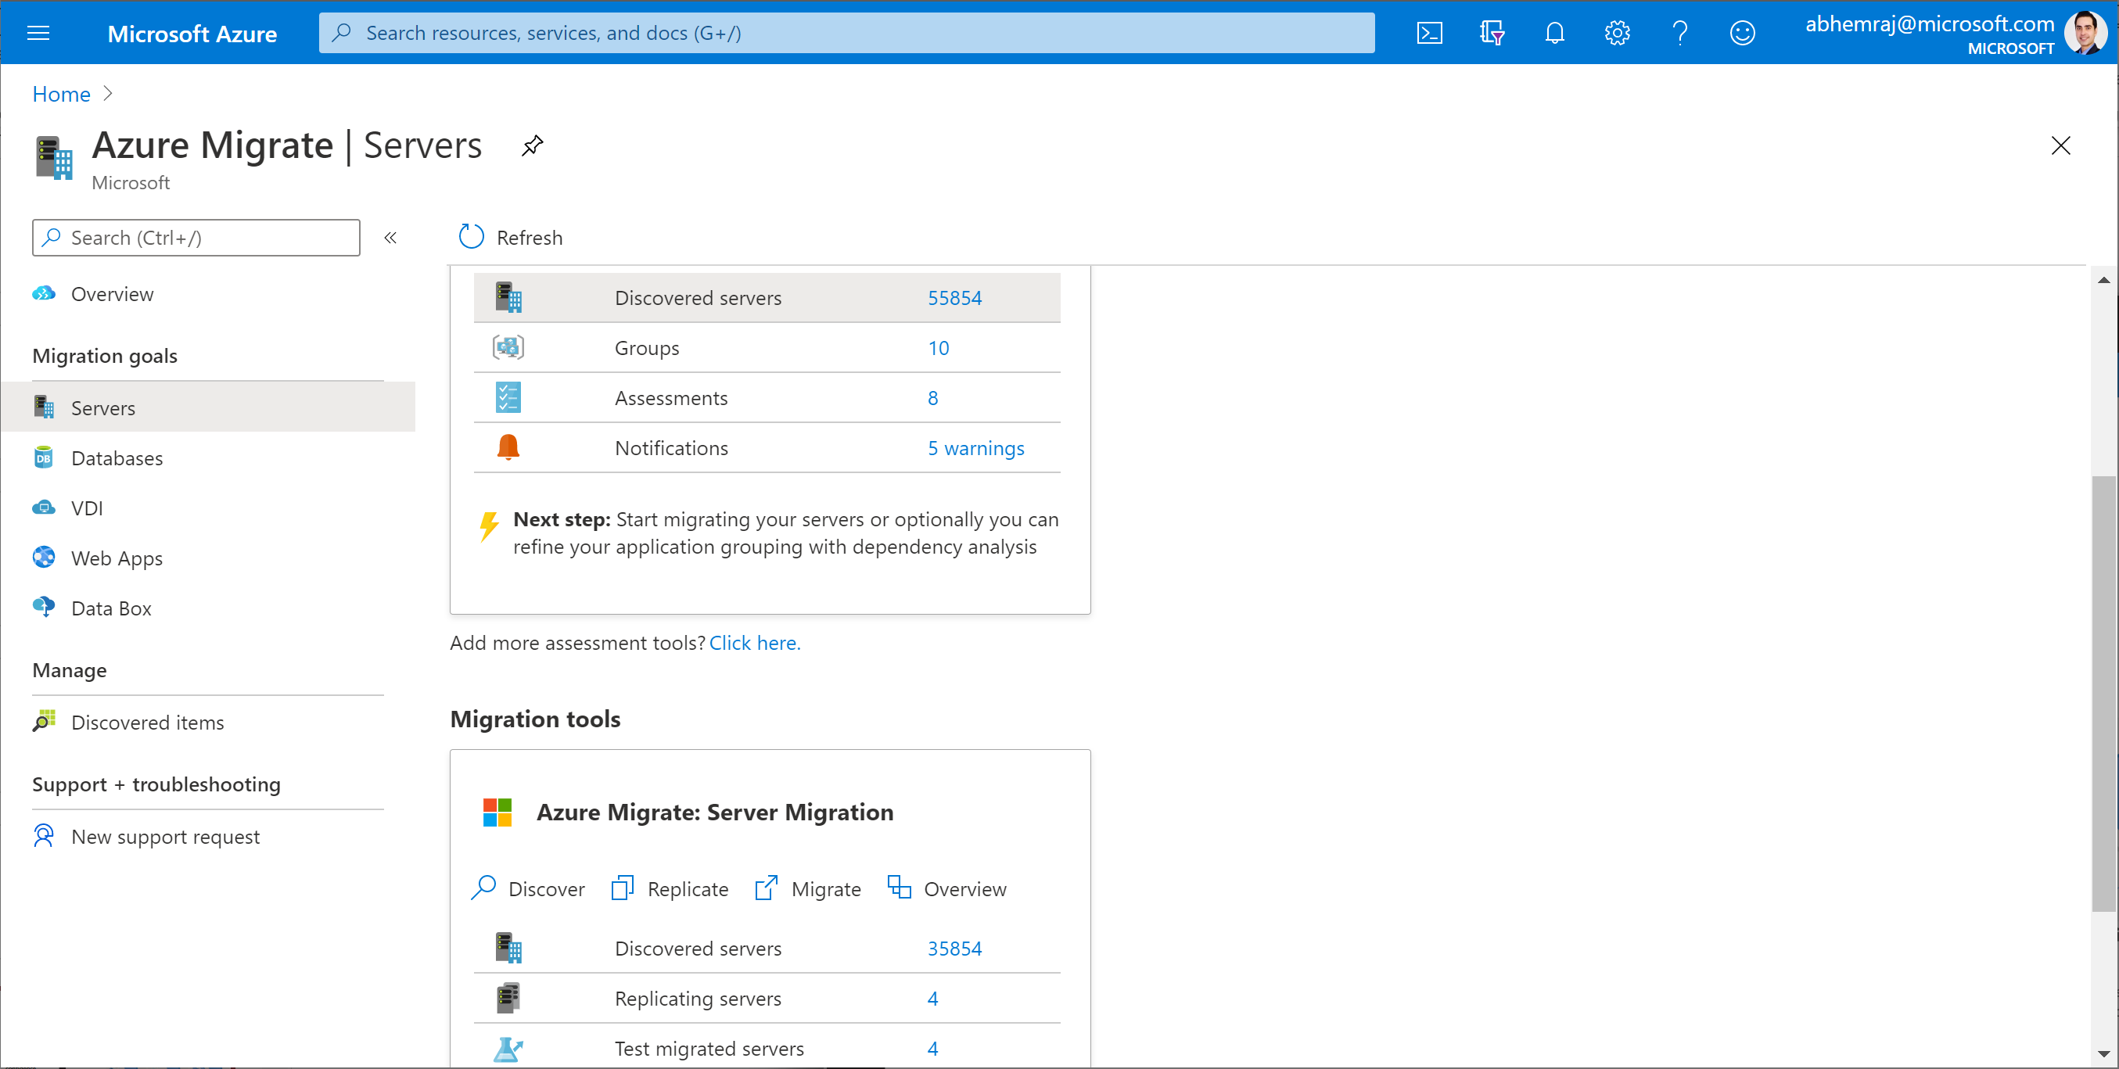
Azure Migrate
A central hub of tools for your datacenter cloud migration
End-to-end visibility
Centralized migration repository delivering end-to-end tracking and insights
Notes:
In the past, cloud migration was overwhelming with disconnected tools in different places. That's why Microsoft introduced Azure Migrate to bring everything together and simplify cloud migration. With one centralized migration service, you can discover and assess your datacenter, and then migrate workloads to Azure.

Slide 11
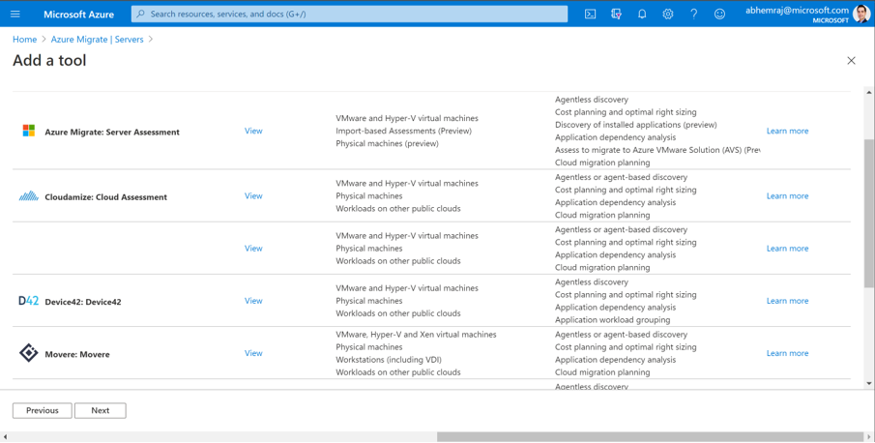


Azure Migrate
A central hub of tools for your datacenter cloud migration
Diverse capabilities
Comprehensive discovery, assessment and migration capabilities powered by Azure and partner tools
Notes:
In the past, cloud migration was overwhelming with disconnected tools in different places. That's why Microsoft introduced Azure Migrate to bring everything together and simplify cloud migration. With one centralized migration service, you can discover and assess your datacenter, and then migrate workloads to Azure.

Slide 12




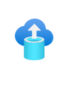



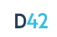



Choice of tools for every stage and every requirement
Servers
Databases
Web apps
VDI
Data
Azure Migrate:
Server Assessment
Azure Migrate:
Database Assessment (DMA)
Azure Migrate: Web App Assessment
Lakeside: SysTrack
Azure Databox
(Third Party Tool)
Azure Migrate:
Server Migration
Azure Migrate: Database Migration (DMS)
Azure Migrate: Web App Migration
Azure Migrate:
Server Migration
Movere
Partner tools
Cloudamize
Turbonomic
UnifyCloud
Device42
RackWare
Notes:
Our goal is to enable successful Azure migration, regardless of what tool was used.
We have a great set of first party Azure tools that are built into the Azure portal and free to get started.
But we also have a great set of third-party tools to meet all your requirements. If you already have a license with any of the Azure Migrate ISVs, you can easily connect the partner tools to Azure Migrate so data from the assessment and migration appears in your Azure Migrate dashboard. Migration is a large project, so Azure Migrate provides one location to track your entire journey.

Slide 13
Discover, asses & migrate servers to Azure
Notes:
Add the original and hide

Slide 14
Industry-leading capabilities
For every step of your migration journey
Azure Migrate: Server assessment
Azure Migrate: Server migration
Discover
Discover servers and configurations
Inventory installed applications and roles
Identify dependencies between servers and applications
Discover SQL Server instances and databases
Assess
Analyze readiness for migration to Azure VM, Azure VMware Solution and Azure SQL
Get sizing recommendation (utilization based right-sizing or configuration-based sizing)
Estimate cloud costs
Understand blockers to migration for Azure SQL
Migrate
Migrate servers and applications with near-zero downtime
Test before migrating
Notes:
Discover: for agentless discovery, you can either use the lightweight Azure Migrate appliance, or use the new Import feature and upload a CSV file to the tool
You can view dependencies between machines in your environment and create groupings from this for your assessment
Once you run an assessment, you’ll get a detailed report of each discovered machine’s readiness for Azure in terms of operating system or disk size, an estimated cost of running on Azure, and also sizing recommendations. The Azure Migrate tool collects information over time about your environment and comes up with an accurate recommendation based on past performance. You can run this for as little as a few days, or for longer for even more precision.
Choose to either keep machines running during the migration or shut them down to ensure no downtime.

Slide 15
Azure Migrate appliance
Unified appliance
For server discovery, assessment and migration.
For VMware: discovery, assessment and migration
For Hyper-V: discovery and assessment
For physical and other clouds: discovery and assessment
Dedicated machine
Installed in source environment
Runs Azure Migrate software to connect to vCenter/Hyper-V host/physical servers/virtual machines to perform discovery
Deployment options
Virtual appliance that can be imported – OVA option for VMware, VHD option for Hyper-V
Installer option on dedicated Windows Server 2016 for all scenarios
Deploy as VM or physical machine
No impact to source
Appliance does not install any software on source VMs or hosts
Notes:
For more info on –
Azure Migrate appliance overview
Appliance deployment options

Slide 16
Azure Migrate appliance
Software components
Azure Migrate Appliance
Management app
Discovery
agent
Collector
agent
Auto update service
DRA agent
Gateway agent
Collector
Available in VMware/ Hyper-V/physical appliance
Available only in VMware appliance (for agentless migration)
Web application interface used to configure the appliance
Collects configuration
data of servers
Collects performance and resource utilization data of servers
Checks and updates appliance components (every 24 hrs.)
Orchestrates
server replication to Azure
Sends replication data to Azure
Notes:
For more info on -
Azure Migrate appliance overview
Appliance Requirements

Slide 17
Discover servers
Notes:
Add the original and hide

Slide 18
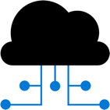
Discover: Capabilities
Any platform
VMware, Hyper-V, physical servers, AWS, GCP
CMDB, CSV imports
Agentless discovery
For all hypervisors, bare-metal servers and servers on other clouds
Inventory applications
And roles enabled on servers (only for VMware)
Multiple server credentials supported
Visualize dependencies
Across application layers or across servers (agentless for VMware)
Multiple server credentials supported
Notes:
For more info on –
Azure Migrate appliance overview
Appliance deployment options

Slide 19




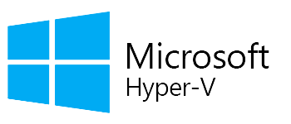


Discovery: Process
For all scenarios
Deploy and configure the Azure Migrate appliance in the source environment
Appliance discovers servers and server configurations, and collects performance data (resource utilizations) for Windows and Linux servers
View discovered servers
Notes:
For more info on -
VMware discovery tutorial
Hyper-V discovery tutorial
Physical server discovery tutorial

Slide 20
Demo: Discover servers
Notes:
Add the original and hide

Slide 21

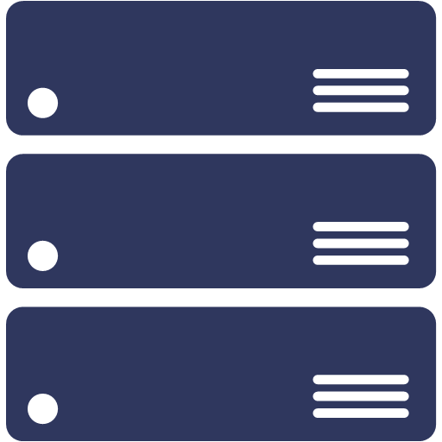



Discovery: Supported versions & pre-requisites
VMware
Hyper-V
Physical/other cloud
Host requirements
ESXi hosts version (5.5 or later)
Host requirements
Windows Server 2012 R2 or later
PowerShell remoting
Administrator permissions
For Windows servers
Local or domain joined account
vCenter requirements
vCenter Server version (5.5, 6, 6.5, 6.7, 7)
Read-only account
For Linux servers
An account with root permissions
Supported VMs
All operating systems
Disks attached to SCSI, IDE, SATA controllers
Supported VMs
All operating systems
Hyper-V Integration Services enabled
Supported VMs
All operating systems
Notes:
For more info on -
VMware discovery support
Hyper-V discovery support
Physical server discovery support

Slide 22
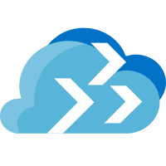

Discovery: Architecture
For VMware VMs
Azure Migrate appliance for VMware
Discovered servers
Configuration data (30 mins)
Configuration data (30 mins)
1
vSphere APIs, TCP 443
HTTPS 443
3
Performance data (20 secs)
Performance data (20 secs)
vCenter Server
2
Azure Migrate
ESXi hosts
vSphere API used | Purpose
Login | Initializes connection to vCenter/ESXi
RetrieveServiceContent | Initializes vSphere management client
RetrievePropertiesEx | Retrieve a list of properties specified by the property filter spec.
ContinueRetrievePropertiesEx | Retrieve a list of properties specified by the property filter spec.
QueryDvsConfigTarget | Gets Distributed Virtual PortGroupInfo on vSphere /ESX host.
CreateContainerView | Get the entities from the vCenter
QueryPerfCounterByLevel | Get counter information for given levels for vCenter server
QueryPerf | Get Performance data points.
Notes:
For more info on -
Prepare VMware for discovery
Deploy appliance for VMware
Data collected for VMware VMs

Slide 23
Discovery: Architecture
For Hyper-V VMs
Azure Migrate appliance for Hyper-V
Discovered servers
Configuration data (30 mins)
Configuration data (30 mins)
1
WinRM 5985
HTTPS 443
3
Performance data (20 secs)
Performance data (20 secs)
Hyper-V hosts
2
Azure Migrate
VMs
Storage
Notes:
For more info on -
Preparing Hyper-V hosts for discovery
Discovering Hyper-V VMs on remote SMB shares
Data collected for Hyper-V VMs

Slide 24

Discovery: Architecture
For physical servers & servers from other clouds (AWS, GCP)
Azure Migrate appliance for physical servers
Discovered servers
Configuration data (30 mins)
Configuration data (30 mins)
1
Windows (WinRM 5985) Linux ( SSH 22)
HTTPS 443
3
Performance data (20 secs)
Performance data (20 secs)
Physical servers
2
Azure Migrate Portal
Physical servers/ AWS VM/GCP VMs/VMs in other clouds
Use a non-root account for Linux server discovery
Ensure the required capabilities are set using the following commands:
setcap CAP_DAC_READ_SEARCH+eip /usr/sbin/fdisk
setcap CAP_DAC_READ_SEARCH+eip /sbin/fdisk (if /usr/sbin/fdisk is not present)
setcap "cap_dac_override, cap_dac_read_search, cap_fowner,cap_fsetid, cap_setuid, cap_setpcap, cap_net_bind_service, cap_net_admin, cap_sys_chroot, cap_sys_admin, cap_sys_resource, cap_audit_control, cap_setfcap=+eip" /sbin/lvm
setcap CAP_DAC_READ_SEARCH+eip /usr/sbin/dmidecode
chmod a+r /sys/class/dmi/id/product_uuid
Notes:
For more info on -
Prepare physical servers for discovery
Deploy appliance for physical servers
Data collected for Physical servers

Slide 25
Discovery: Data management
For all scenarios
 | Configuration data | Performance data
Polling interval | Collected every 30 mins Differential sent to Azure every 30 mins | Collected every 20 secs. (VMware); 30 secs (Hyper-V); 5 mins. (physical servers) Aggregated every 10 mins. based on peak value Peak points transmitted to Azure
Secure Hashing Algorithm | SHA 256 (in transit and at rest) | SHA 256 (in transit and at rest)
Datastore | Azure Cosmos DB in Microsoft subscription | Azure Data Explorer in Microsoft subscription
Retention | 3 days post VM removal from discovery Migrate project deletion | Auto-deletion after 30 days; sooner if Azure Migrate project is deleted
Storage region | Any region within Migrate project geography | Any region within Migrate project geography
Appliance component used | Discovery agent | Collector agent
Notes:
For more info on -
Data collected for VMware VMs
Data collected for Hyper-V VMs
Data collected for Physical servers

Slide 26
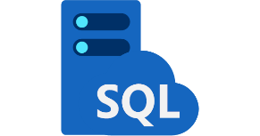
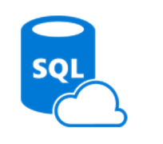



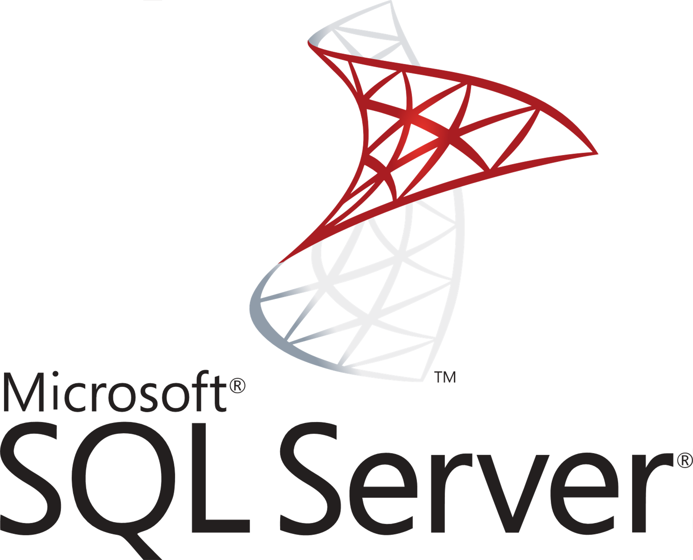
SQL discovery: Process
Deploy and configure the Azure Migrate appliance in the source environment
Appliance discovers servers and server configurations, and collects performance data (resource utilizations) for Windows, Linux, and SQL Server
Perform assessments to determine
Readiness for Azure SQL
Recommended Azure SQL target
Migration blockers and warnings
Azure SQL configuration (SKU)
Estimated monthly cost

Slide 27
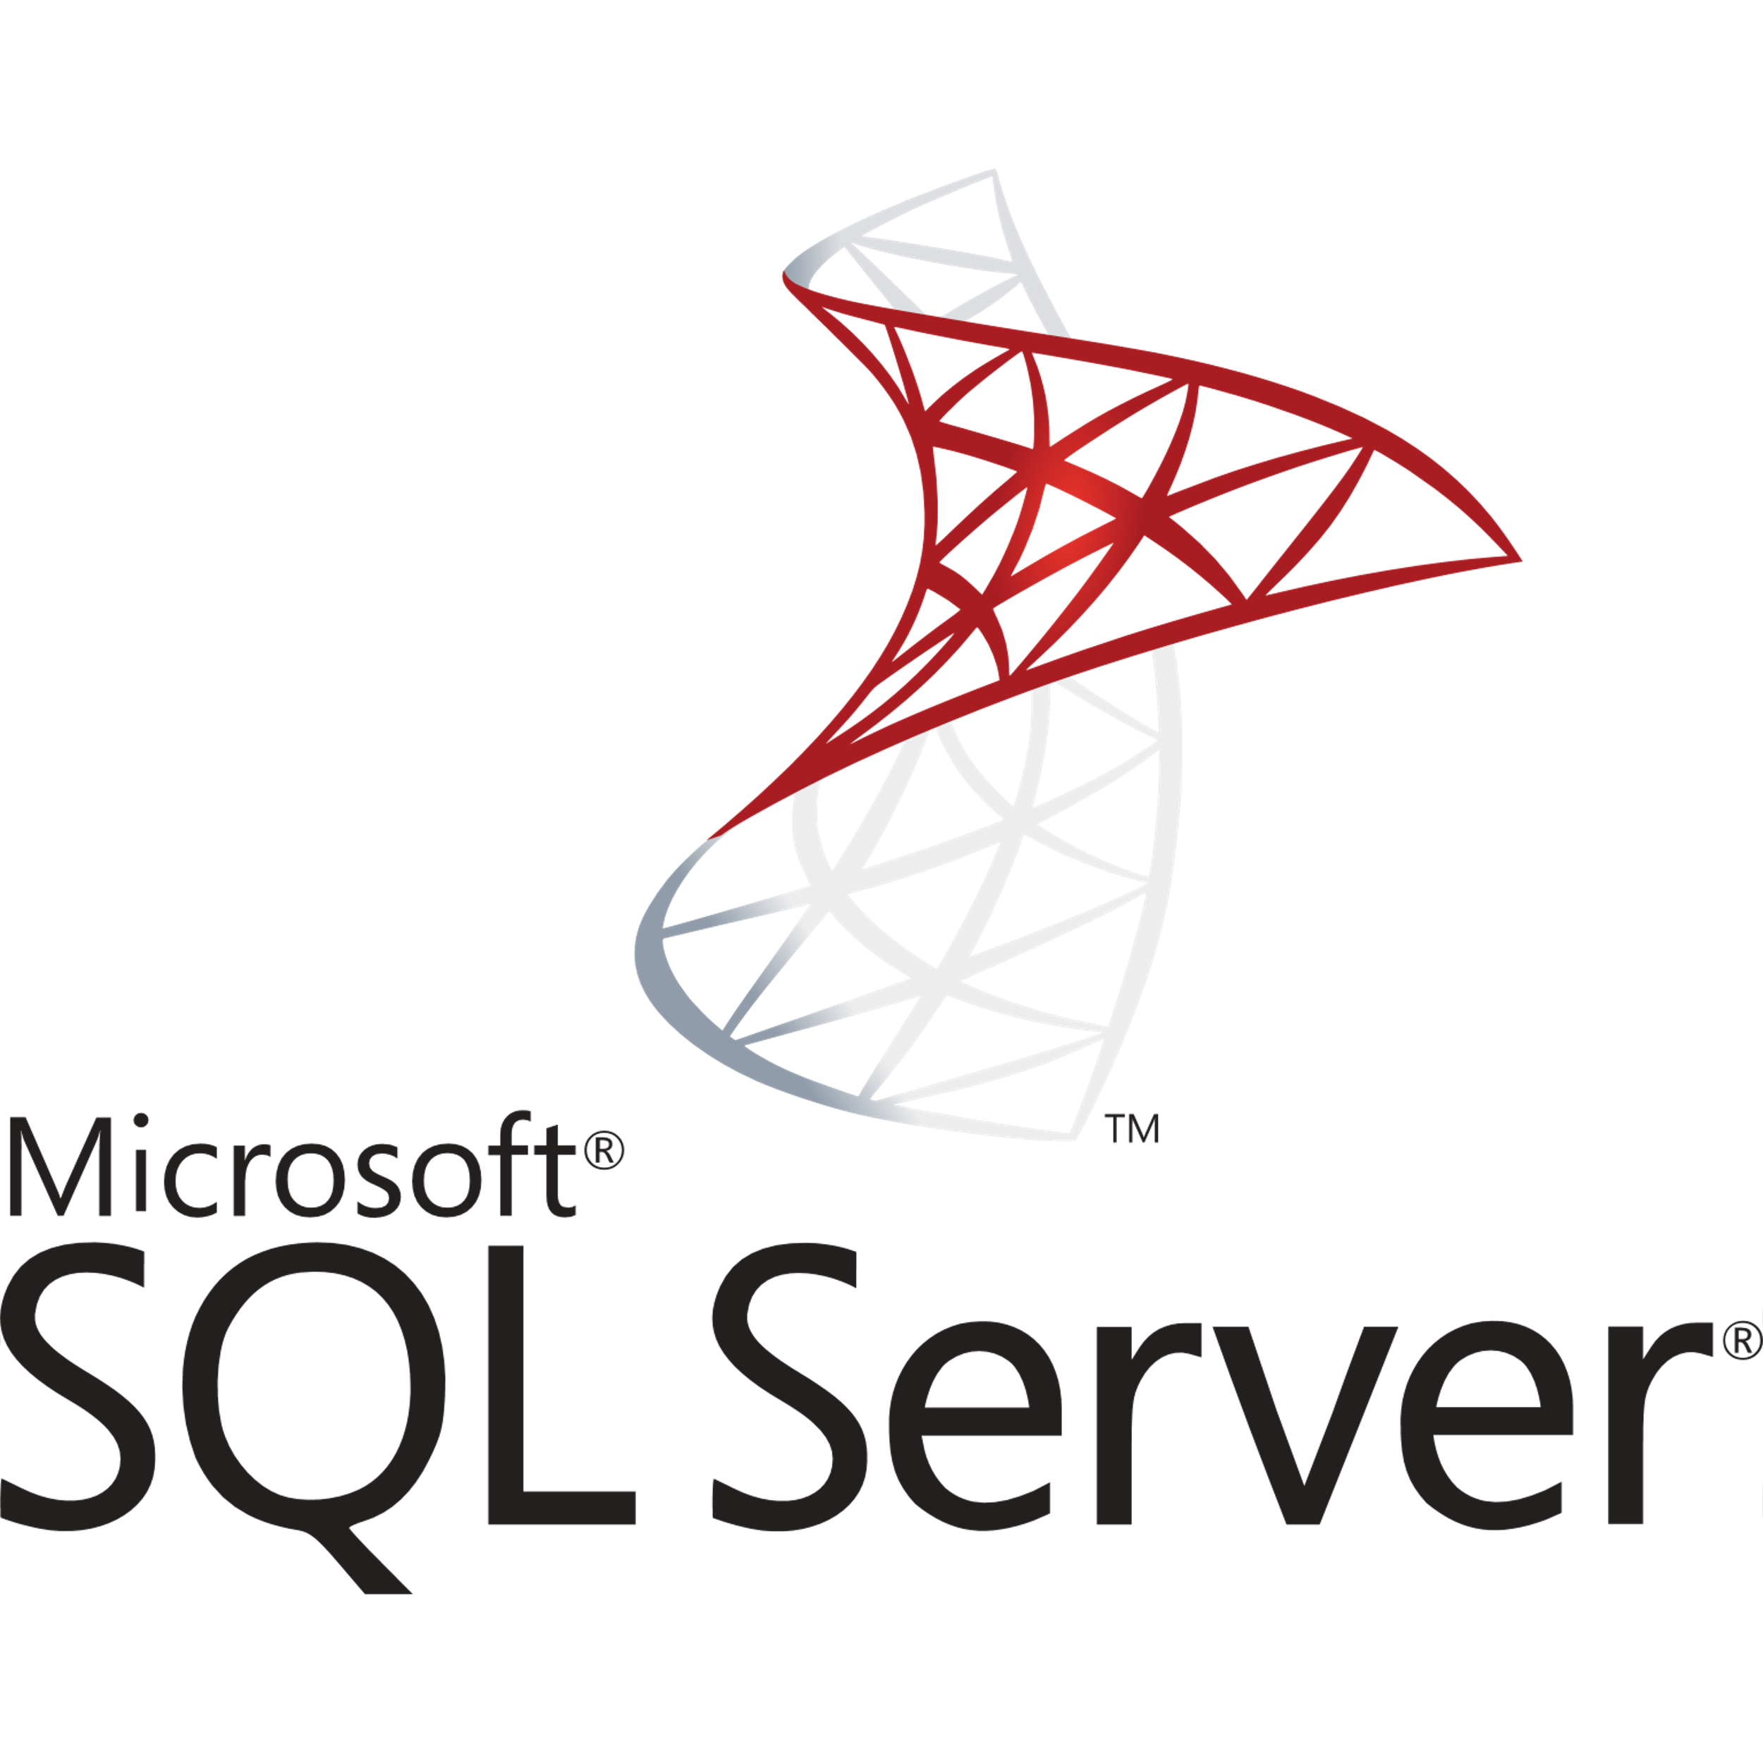
SQL discovery: Supported versions & pre-requisites
VMware
SQL Server
Host requirements
ESXi hosts version (5.5 or later)
Configuration
Standalone SQL Server instances with databases
Sysadmin server role for accessing SQL servers
Failover Clusters and Always On availability groups are not supported
Services
SQL Server Database Engine
SQL Server Reporting Services, Integration Services, Analysis Services are not supported
vCenter requirements
vCenter Server version (5.5, 6, 6.5, 6.7, 7)
Read-only account
Supported VMs
Windows Server 2008 and above
Supported Versions
SQL Server 2008 and above
Enterprise, Standard, Developer, Web and Express editions
Notes:
For more info on -
VMware discovery support
Hyper-V discovery support
Physical server discovery support

Slide 28


SQL discovery: Architecture
Application inventory
Azure Migrate appliance for VMware
Server discovery
HTTPS 443
Installed apps (24 hrs.)
SQL instances and databases
(configuration and performance data)
vCenter Server
TCP 443
SQL instances and databases (24 hrs.)
Azure Migrate Portal
vCenter account with Virtual Machines -> Guest Operations privilege
Installed apps (24 hrs.)
SQL instances and databases* (24 hrs.)
ESXi hosts
*Data collection for SQL instances:
Configuration data is collected every 24 hours
Performance data is collected every 30 seconds

Slide 29
SQL discovery: Data management
 | Configuration data | Performance data
Polling interval | Collected every 24 hours (config changes are refreshed every 24 hours) | Collected every 30 secs Aggregated every 10 mins Min, Max, Mean and Variance are transmitted to Azure
Secure Hashing Algorithm | SHA 256 (in transit and at rest) | SHA 256 (in transit and at rest)
Datastore | Azure Cosmos DB in Microsoft subscription | Azure Data Explorer in Microsoft subscription
Retention | 3 days post SQL instance/ database/ server removal Migrate project deletion | Auto-deletion after 30 days
Storage region | Any region within Migrate project geography | Any region within Migrate project geography
Appliance component used | SQL discovery and assessment agent | SQL discovery and assessment agent

Slide 30
Discovery: Resource Limits
Azure Migrate project
35000 servers (individually for each scenario) Same project can be used for multiple scenarios
Per Azure Migrate appliance
VMware
1 vCenter server 10000 servers 400 servers (dependency analysis)
*Discovery scoping supported
Hyper-V
300 hosts 5000 VMs
Physical/other cloud
1000 physical servers
Notes:
For more info on -
Discovering VMware at scale
Discovering Hyper-V at scale
Discovering physical servers at scale

Slide 31
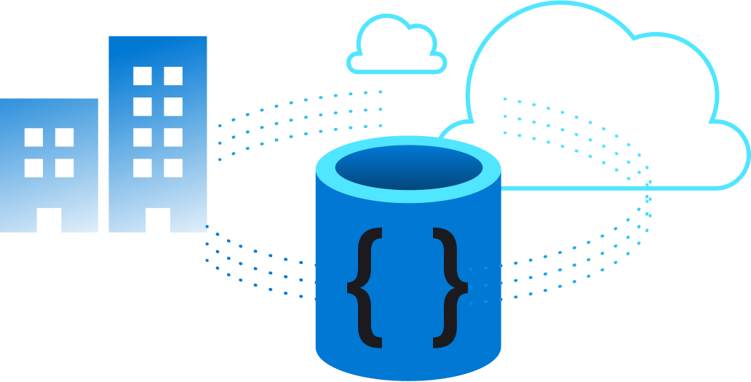
Discovery: How to scope
For VMware VMs
For vCenter >10000 servers
Deploy multiple appliances (one per 10000 VMs)
Use multiple vCenter accounts (one account per appliance)
Configure the permissions scope for the vCenter accounts, such that each account/appliance discovers a mutually exclusive set of VMs on the vCenter
Overlapping VM discovery leads to
Incorrect count of servers in assessments
Inability to select VM for replication if same VM is discovered through multiple VMware appliances in the same project
Notes:
For more info on -
Scoping VMware discovery

Slide 32
Discover applications and dependencies

Slide 33


Dependency analysis: Supported versions & pre-requisites
VMware (agentless)
Hyper-V/ physical servers/
other cloud servers
On VMs PowerShell 2.0 VMware tools 10.2.0 or later Administrator account
On vCenter Read-only account with Virtual Machines -> Guest Operations privilege
Supported VMs Windows Server 2008 R2 and above Red Hat Enterprise Linux 7, 6, 5 Ubuntu Linux 14.04, 16.04 Debian 7, 8 Oracle Linux 6, 7 CentOS 5, 6, 7
On VMs Microsoft Monitoring agent Dependency agent
On Azure Log Analytics workspace
Supported VMs All except Windows Server 2003 SUSE Linux
*These are in addition to the pre-requisites called out for server discovery
Notes:
For more info on -
Dependency analysis

Slide 34
Dependency analysis: Process
Agentless for VMware VMs
Deploy and configure the Azure Migrate appliance in the source environment (vCenter and server creds)
Appliance discovers servers and server configurations, applications and roles, and collects performance data for Windows and Linux servers
Enable dependency analysis for eligible servers from Azure Portal
View application inventory, roles on servers, and dependencies across servers
Notes:
For more info on -
Agentless dependency analysis
VMware application inventory

Slide 35
Dependency analysis: Architecture
For VMware VMs
Application inventory
Azure Migrate appliance for VMware
Server discovery
HTTPS 443
3
vCenter Server
Installed apps (24 hrs.)
2
App dependencies (6 hrs.)
Azure Migrate Portal
Dependencies
vCenter account with Virtual Machines -> Guest Operations privilege
Installed apps (24 hrs.)
App dependencies (5 mins)
TCP 443
ESXi hosts
Use a non-root account for Linux server dependency analysis
Ensure the required capabilities are set using the following commands:
sudo setcap CAP_DAC_READ_SEARCH,CAP_SYS_PTRACE=ep /bin/ls
sudo setcap CAP_DAC_READ_SEARCH,CAP_SYS_PTRACE=ep /bin/netstat
* Dependency analysis can only be enabled on successfully validated servers
* Required for software inventory and agentless dependency analysis
Notes:
For more info on -
Agentless dependency analysis process
Data collected for installed apps
Data collected for dependencies

Slide 36
Dependency analysis:
Agent-based for Hyper-V VMs/physical servers/AWS, GCP, other cloud services
Configure Azure Log Analytics and Service Map with Azure Migrate project
Deploy Microsoft Monitoring Agent (MMA) and dependency agent on source servers
Agents send dependency information from Windows and Linux servers to Log Analytics workspace linked to Azure Migrate Project
View dependencies across servers
Notes:
For more info on -
Agent-based dependency analysis

Slide 37

Dependency analysis: Architecture
Agent-based for Hyper-V VMs/physical servers/AWS, GCP, other cloud services
For more info on:
→ Agent-based dependency analysis process → Query dependency data
Server discovery
Source environment
Azure Migrate appliance
Azure Migrate Portal
Dependencies
Hosts or servers
App dependencies data
Microsoft Monitoring agent (MMA) and Dependency agent
Azure Log Analytics and Service Map

Slide 38
Dependency Analysis: Process
For agentless and agent-based
 | Agentless | Agent-based
Supported scenario | All Windows & most Linux distros (on VMware) Azure Public & Government clouds | All Azure Migrate supported Windows/Linux OS Azure Public cloud
Data Collection Process | Collected and processed every 5 mins Transmitted to Azure every 6 hours | Service Map agents gather data for each process and send it to Log Analytics workspace
Data gathered | Source server name, process, application name Destination server name, process, application name, and port | Source server name, process, application name Destination server name, process, application name, and port Number of connections, latency and data transfer
Visualization support | Single server dependency map Customizable (1 hour - 30 days) | Single or multi-server dependency map Cannot be customized
Data Export | Last 30 days data in CSV | Log Analytics query
Pricing | Free | Free for first 180 days
Notes:
For more info on -
Dependency analysis

Slide 39
Demo: Dependencies

Slide 40
Assess servers for migration

Slide 41

Assessment: Capabilities
Any platform
VMware, Hyper-V, physical servers, AWS, GCP, and other clouds
CMDB, CSV imports
Multiple types
Performance based (resource utilization- based right sizing) and configuration match-based sizing options
Analyze & optimize
Identify readiness and right size infrastructure through recommendations
Instant & customized
Computed real time on parameters (platform, compute and storage type, region, duration, offers etc.)
Notes:
For more info on –
Azure Migrate appliance overview
Appliance deployment options

Slide 42
Assessment: Process
Deploy the Azure Migrate appliance
Appliance starts collecting configuration data and analyzing performance of your Windows and Linux servers (as part of discovery)
Perform assessments to determine
Azure suitability
Right-sizing information
Cost planning
For all scenarios and targets (Azure VMs, AVS)
Notes:
For more info on -
VMware assessment tutorial
Hyper-V assessment tutorial
Physical server assessment tutoria

Slide 43
Assessment: Architecture
Import-based for Azure VM and AVS assessment
Import through CSV
Source environment
CMDB
Azure Migrate Portal
Hosts or servers
Create a quick assessment without deploying the appliance
Import existing CMDB data through a CSV file
Notes:
For more info on -
Imported server assessmen

Slide 44
Assessment for Azure VMs: Process
Stages and computation criteria
Azure Readiness
Sizing
Monthly costs
Parameters
Boot type
Cores
RAM
Storage disk
Networking
Operating system
Parameters
Storage
Network
Compute
Allocated or used depends on assessment type
Parameters
Azure VM size output from stage 2
Software Assurance
Reserved instances
VM uptime
Location
Azure Hybird Benefit (Windows OS)
Output
Readiness for migration to Azure VM
Recommended tool for migration
Output
Azure VM size recommendation
Storage disk recommendation
Confidence rating (for performance based)
Confidence ratings are computed based on available data points
Output
Per VM monthly compute and storage costs
Aggregated compute and storage costs
Notes:
For more info on -
VMware discovery support
Hyper-V discovery support
Physical server discovery support

Slide 45
Assessment for AVS: Process
Stages and computation criteria
Azure Readiness
Sizing
Monthly costs
Parameters
Internet Protocol
Parameters
Compute
Storage
Node type
Allocated or used depends on assessment type
Parameters
AVS node output from stage 2
Location
AVS node type
Output
Readiness for migration to AVS
Recommended tool for migration
Output
Number of AVS nodes
Projected compute and storage utilization across nodes
Confidence rating (for performance based)
Confidence ratings are computed based on available data points
Output
Aggregated costs
Per VM monthly costs
Per VM cost is calculated by dividing aggregated cost by number of VMs in assessment
Notes:
For more info on -
VMware discovery support
Hyper-V discovery support
Physical server discovery support

Slide 46
Assessment: Right-sizing computation
For performance-based
1
2
3
4
5
Discovery is initiated
Appliance collects performance data points
Frequency – 20 secs. for VMware, 30 secs. for Hyper-V, 5 mins. for physical servers
Appliance identifies 1 peak data point for every 10 mins. (max value)
Appliance transmits the peak data points to Datastore
Data points are sorted in ascending order and selects the 95th or 99th percentile data point for right sizing
Notes:
For more info on -
Data collected for VMware assessment
Data collected for Hyper-V assessment
Data collected for Physical server assessment

Slide 47
Assessment: Confidence rating computation
For performance-based
Computation formula:
Output is categorized as:
0 to 20% data points
Confidence rating
Actual data point received
100 pts
x
20 to 40% data points
Expected data points
40 to 60% data points
Duration of assessments in mins
60 to 80% data points
Expected data points
10 mins
80 to 100% data points
Low confidence ratings indicate fewer data points availability. Could be due to:
Shorter profiling period (performance history duration > actual period for which data was available)
On-prem VMs shutdown
Appliance unable to load perf data
Temporary appliance shutdown
Notes:
For more info on -
Confidence ratings

Slide 48
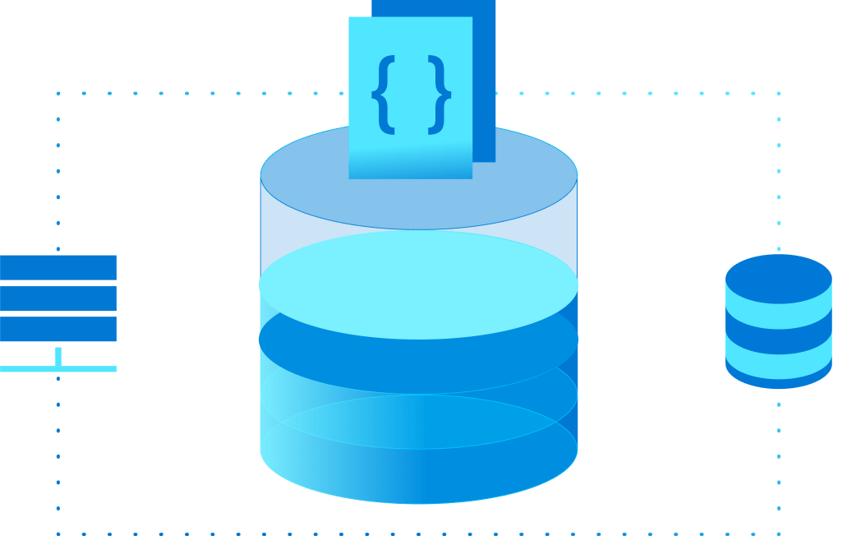
Azure VM assessment: Customizations
Can compute multiple assessments for the same server to compare
Can be customized to account for:
Target location
Storage type: Standard or Premium
Reserved instances
VM Series
Sizing criteria
Performance history
Percentile utilization
Comfort factor
VM uptime
Currency
Offer
Discount
EA subscription
Azure Hybrid Benefit
Compute for 1 day, 7 days, or 30 days
Account for load seasonality and growth
Account for offers and discounts
Notes:
For more info on -
Customizing assessments

Slide 49
Azure VMware Solution assessment: Customizations
Can compute multiple assessments for the same server to compare
Can be customized to account for:
Target location
Node type
Sizing criteria
Performance history
Percentile utilization
Comfort factor
FTT Setting, RAID Level
Currency
vCPU Oversubscription
Memory overcommit factor
Dedupe and compression factor
Currency
Offer
Discount
Compute for 1 day, 7 days, or 30 days
Account for load seasonality and growth
Account for offers and discounts
Notes:
For more info on -
Customizing assessments

Slide 50
Demo: Assessments

Slide 51
Assess SQL Server instances and databases

Slide 52



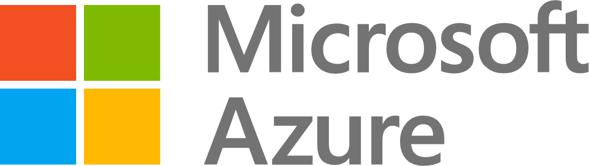
SQL assessments: Options
Azure Migrate
Azure VM assessment
Azure Virtual Machine
vCenter Server
Azure Migrate
Azure SQL assessment
Azure SQL Database
ESXi hosts and servers running SQL Server
Azure Migrate
Azure SQL assessment
Azure SQL Managed Instance

Slide 53
SQL assessment: Confidence rating computation
Computation formula:
Output is categorized as:
0 to 20% data points
Confidence rating
Actual data point received
100 pts
x
20 to 40% data points
Expected data points
40 to 60% data points
Duration of assessments in mins
60 to 80% data points
Expected data points
10 mins
80 to 100% data points
Low confidence ratings indicate fewer data points availability. Could be due to:
Shorter profiling period (performance history duration > actual period for which data was available)
On-prem VMs shutdown
Appliance unable to load perf data
Temporary appliance shutdown
Notes:
For more info on -
Confidence ratings

Slide 54
SQL assessments: Customizations
Can compute multiple assessments for the same server to compare
Can be customized to account for:
Target location
Target deployment type
Reserved capacity
Percentile utilization
Performance duration
Comfort factor
Service tier
Currency
Offer
Discount
Azure Hybrid Benefit
Microsoft recommended or targeted to Azure SQL Database or Azure SQL Managed Instance
Compute for 1 day, 1 week, or 1 month
Business critical or General Purpose
Account for offers and discounts

Slide 55
SQL assessments: Right-sizing computation
1
2
3
4
5
Discovery is initiated
Appliance collects performance data points
Frequency –30 secs. for SQL instances
Appliance aggregates the sample data points collected every 30 seconds over 10 minutes and sends max, mean, variance, occurrence for each counter
Service calculates normalized values of counters sent by the appliance
Percentile logic selected by the user is applied on the normalized data points

Slide 56
Migrate servers to Azure

Slide 57



Migration: Capabilities
Multiple options
Agentless migrations for VMware and Hyper-V virtual machines
Agent-based for other scenarios
Migrate at scale
Supports migrating 100s of servers simultaneously and automation options to execute at scale
Test before migrating
Perform testing cycles before migrating without impacting source server and ongoing replication
Zero data loss
And minimal downtime during migration

Slide 58
Migration: Overview
Azure Migrate: Server migration vs Azure Site Recovery
 | Azure Migrate: Server migration | Azure Site Recovery
Scenario | Purpose-built for server migration to Azure | Built for disaster recovery (DR) for servers
Options | Agentless for VMware & Hyper-V Agent-based | Agent-based (migrating with DR constructs)
Pricing | Free tooling (migrate within 180 days per machine) Pay for only storage and network Compute charges for test migration | Free tooling for 31 days (charges per server instance)
Feature support | Integrated end-to-end journey tracking Carry forward assessments for migration Migration centric features (custom resource naming, tagging, automatic Azure VM agent install etc.) | Disaster recovery-centric features
Recommended use | Migration to Azure | Disaster recovery of Azure VMs and for hybrid disaster recovery scenarios
Pricing | Free | Free for first 180 days
Both tools share certain components. Recovery Services vault is used by Azure Migrate: Server Migration, Disaster Recovery, and Azure Backup.
Common components are used for replication in the Hyper-V and agent-based replication scenarios.
Notes:
For more info on -
Azure Migrate overview

Slide 59
Migration: Scenarios
Agentless VMware
Agentless Hyper-V
Physical/other cloud
Requirements
Uses the Azure Migrate appliance
No software on VMs
Requirements
Uses Hyper-V Replication Provider installed on hosts
No software on VMs
Requirements
Uses replication appliance (configuration & process server) installed on dedicated machine
Uses mobility service installed on servers
Scale
500 concurrent replications
Scale
Limited by space available on Hyper-V hosts
Scale
Scale out with additional Process server
*This method can also be used to migrate VMware or Hyper-V servers by treating them as physical servers
Notes:
For more info on -
VMware discovery support
Hyper-V discovery support
Physical server discovery support

Slide 60
Migration: Stages
For all scenarios
Enable replication
Initial
replication
Delta
replication
Migrate
Stop
replication
Start test migration
Cleanup test migration

Slide 61
Migration: Supported versions & pre-requisites
VMware
Hyper-V
Physical/other cloud
Host requirements
ESXi hosts version (5.5 or later)
Host requirements
Windows Server 2012 R2 or later
.NET 4.7 or later
Administrator permissions
In source environment
Install replication appliance on dedicated machine
Install Mobility service on servers to be migrated
vCenter requirements
vCenter Server version (5.5, 6, 6.5, 6.7, 7)
vCenter Server permissions
Supported VMs
All Azure supported operating systems
Supported VMs
All Azure supported operating systems
Hyper-V Integration Services enabled
Supported VMs
Most 64-bit Linux distros
Windows 2008 or later
Windows 7 and above
Notes:
For more info on -
VMware migration support
Hyper-V migration support
Physical server migration support

Slide 62
Agentless VMware migrations

Slide 63
Agentless VMware: Process
Deploy and configure the Azure Migrate appliance for VMware and complete server discovery
Start replicating your Windows and Linux servers
The Azure Migrate appliance orchestrates the replication of your VM data to your Azure subscription
Perform test migrations (optional, but highly recommended) to a sandbox environment with no impact to production to validate migration
Migrate to Azure with zero data loss and minimal downtime
Sandbox environment
Notes:
For more info on -
Agentless VMware migration tutorial

Slide 64





Agentless VMware: Architecture
Azure Migrate
Azure Migrate appliance for VMware
Replication orchestration
Replication orchestration
1
Snapshot and CBT requests (TCP 443)
2
TCP 902
Replication orchestration and data upload
(HTTPS 443)
3
4
vCenter Server
Storage Account
Data transfer to managed disks
Replication data
Service Bus
ESXi hosts
Key Vault
Technologies used:
VMware Change Block Tracking (CBT)
VMware Snapshots
VMware VDDK
Recovery Services Vault
Datastore
Notes:
For more info on -
Agentless VMware migration architecture

Slide 65
Agentless VMware: Azure artifacts created
Operation | Azure Migrate: Server migration | Azure Site Recovery
Register appliance with Azure Migrate | 1 AAD apps 1 Key Vault 1 Recovery Services Vault | AAD App – Acts as the unique identity of the Azure Migrate appliance in communications between agents on the appliance and the Azure Migrate Service and to access Key Vault during migration Key Vault – Used for management of certificate downloaded on the appliance during configuration Recovery Services Vault - Used for Server Migration to orchestrate data replication
Start first replication | 1 Key Vault 2 Storage Accounts 1 Service Bus | Key Vault – Used for managing access keys to storage accounts used during replication Service Bus – Used by Azure Migrate Gateway agent on the appliance to communicate with Azure Migrate service for replication orchestration Storage Account 1 – Used by appliance to upload replicated data Storage Account 2 – Used by appliance to upload replication logs
Notes:
For more info on -
Azure artifacts created

Slide 66
Agentless VMware: Replication cycle scheduling
Scheduling per VM
Prioritization across concurrent replications
Initial replication is scheduled when replication is configured for a VM
Delta replication scheduling:
First delta cycle is scheduled immediately after Initial Replication cycle completes
Next delta replication cycle = max [(Previous cycle time/2), 1 hour]
On triggering migration, an on-demand delta replication cycle is performed for the VM prior to the migration
For VMs on the same ESXi host:
Ongoing VM replications are prioritized over scheduled replications (new replications)
Pre-Failover (delta replication) > initial replication cycle > delta replication cycle

Slide 67
VMware VMs: Agentless or agent-based
Recommended
Have access to vCenter server?
Yes
VMs support snapshots
(no independent disks etc.)
Yes
Datastore has capacity to hold VM snapshots
Yes
Use agentless option
No
No
No
No
Use agent-based option
Notes:
For more info on -
VMware migration options

Slide 68
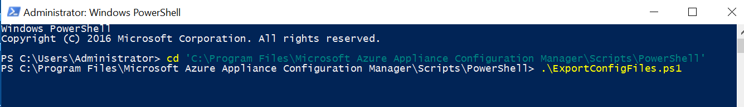
Agentless VMware: Scale-out process
Deploy and configure the Azure Migrate appliance for VMware and complete server discovery
Deploy the scale-out appliance
Start replicating your Windows and Linux servers
The Azure Migrate appliance orchestrates the replication of your VM data to your Azure subscription
Configure the scale-out appliance after starting the replication of at least one VM
Start replicating more Windows and Linux servers
Perform test migrations (optional, but highly recommended) to a sandbox environment with no impact to production to validate migration
Migrate to Azure with zero data loss and minimal downtime
Migrate 500 VMs concurrently
Sandbox environment
Notes:
For more info on -
Agentless VMware migration tutorial

Slide 69
Agentless VMware: Scale-out architecture
Azure Migrate
Azure Migrate appliance for VMware
Replication orchestration
Replication orchestration
1
Snapshot and CBT requests (TCP 443)
Replication orchestration and data upload
(HTTPS 443)
3
2
TCP 902
4
vCenter Server
Storage Account
Data transfer to managed disks
Replication data
Replication data upload
(HTTPS 443)
Azure Migrate scale-out appliance for VMware
Service Bus
ESXi hosts
Key Vault
Technologies used:
VMware Change Block Tracking (CBT)
VMware Snapshots
VMware VDDK
Recovery Services Vault
Datastore
Notes:
For more info on -
Agentless VMware migration architecture

Slide 70
Agentless Hyper-V migrations

Slide 71
Agentless Hyper-V: Process
Deploy Hyper-V Replication Provider on Hyper-V host
Start replicating your Windows and Linux servers using Azure Migrate: Server Migration
The Hyper-V Replication Provider orchestrates the replication of your VM data to your Azure subscription
Perform test migrations to a sandbox environment with no impact to production to validate migration
Migrate to Azure with zero data loss and minimal downtime
Sandbox environment
Deploy Hyper-V Replication Provider on Hyper-V host
Start replicating your Windows and Linux servers using Azure Migrate: Server Migration
The Hyper-V Replication Provider orchestrates the replication of your VM data to your Azure subscription
Perform test migrations to a sandbox environment with no impact to production to validate migration
Migrate to Azure with zero data-loss and minimal downtime
Notes:
For more info on -
Agentless Hyper-V migration tutorial

Slide 72
Agentless Hyper-V: Architecture
Azure Migrate
Replication orchestration
Replication orchestration
Hyper-V Replication Provider
Replication orchestration and data upload
(HTTPS 443)
2
1
Storage Account
Data transfer to managed disks
Hyper-V hosts
Recovery Services Vault
VMs
Storage
Technologies used:
Hyper-V snapshots (for initial replication)
Hyper-V replica (for delta replication)
Notes:
For more info on -
Customizing assessments

Slide 73
Agentless Hyper-V: Azure artifacts created
Operation | Azure Migrate: Server migration | Azure Site Recovery
Register Azure Migrate appliance (discovery and assessment) with Azure Migrate | 1 AAD apps 1 Key Vault | AAD app – Used for communication between agents on appliance and Azure Migrate Key Vault – Used for management of certificate downloaded on the appliance during configuration
Register Hyper-V Replication Provider | 1 Recovery Services Vault | Recovery Services Vault - Used for replication orchestrations
Start first replication | 1 Storage Accounts | Storage Account – Used by appliance to upload replicated data
Notes:
For more info on - Azure artifacts created

Slide 74
Agent-based migrations

Slide 75
Agent-based: Process
Deploy Replication appliance (also known as configuration server) in your source environment
Install Mobility Service on the servers to be migrated
Start replicating your Windows and Linux servers using Azure Migrate: Server Migration
Replication appliance orchestrates the replication of your VM data to your Azure subscription
Perform test migrations to a sandbox environment with no impact to production to validate migration
Migrate with minimal downtime
For physical servers/AWS, GCP, other cloud servers
Sandbox environment
Deploy Hyper-V Replication Provider on Hyper-V host
Start replicating your Windows and Linux servers using Azure Migrate: Server Migration
The Hyper-V Replication Provider orchestrates the replication of your VM data to your Azure subscription
Perform test migrations to a sandbox environment with no impact to production to validate migration
Migrate to Azure with zero data-loss and minimal downtime
Notes:
For more info on -
Agent-based migration tutorial for physical
Agent-based migration tutorial for AWS

Slide 76
Agent-based: Components used
Replication appliance and Mobility service
Replication appliance
Deployed on a dedicated Windows Server 2016 server
Deployment options
Import OVA (VMware only) | Prepare 2016 OS machine and run installer
Configuration Server
Configuration Server
Centralized orchestration of data replication and communication from on-premises to Azure
Process server
Replication gateway. Receives replication data; optimizes it with caching, compression and encryption, and sends it to Azure
Process
Server
Mobility Service
Deployed on each source server to be migrated
Captures data writes from memory and sends replication data from source server to Process server
Notes:
For more info on -
Agent-based migration components

Slide 77
Agent-based: Architecture
Azure Migrate
Replication orchestration
Replication orchestration
Mobility Service
Replication orchestration and data upload (HTTPS 443)
Orchestration data (HTTPS 443)
1
2
Replication data (HTTPS 9443)
1
3
Storage Account
Data transfer to managed disks
Replication appliance
(configuration server and process server)
Physical servers/ AWS VM/ GCP VMs/ VMs in other clouds
Recovery Services Vault
Notes:
For more info on -
Customizing assessments

Slide 78
Agent-based: Azure artifacts created
Operation | Azure Migrate: Server migration | Azure Site Recovery
Register Azure Migrate appliance (discovery and assessment) with Azure Migrate | 1 AAD apps 1 Key Vault | AAD app – Used for communication between agents on appliance and Azure Migrate Key Vault – Used for management of certificate downloaded on the appliance during configuration
Register replication appliance (Configuration Server) | 1 Recovery Services Vault | Recovery Services Vault - Used for replication orchestrations
Start first replication | 1 Storage Accounts | Storage Account – Used by appliance to upload replicated data
Notes:
For more info on -
Azure artifacts created

Slide 79
Agent-based: Scaling
Identify need for additional process server based on following limits
Process server limits
CPU | Memory | Free space – data caching | Churn rate | Replication limits
8 vCPUs (2 sockets * 4 cores @ 2.5 GHz) | 16 GB | 300 GB | 500 GB or less | <100 machines
12 vCPUs (2 sockets * 6 cores @ 2.5 GHz) | 18 GB | 600 GB | 501 GB - 1 TB | 100-150 machines
16 vCPUs (2 sockets * 8 cores @ 2.5 GHz) | 32 GB | 1 TB | 1 TB - 2 TB | 151-200 machines
Notes:
For more info on -
Replication appliance capacity

Slide 80
Agent-based: Scaling
Scale concurrent replications by deploying additional process server based on following parameters
Scale-out process server sizing
CPU | Memory | Free space – data caching | Churn rate | Replication limits
4 vCPUs (2 sockets * 2 cores @ 2.5 GHz) 8-GB memory | 300 GB | 250 GB or less | <85 machines | 4 vCPUs (2 sockets * 2 cores @ 2.5 GHz) 8-GB memory
8 vCPUs (2 sockets * 4 cores @ 2.5 GHz) 12-GB memory | 600 GB | 251 GB - 1 TB | 86 - 150 machines | 8 vCPUs (2 sockets * 4 cores @ 2.5 GHz) 12-GB memory
12 vCPUs (2 sockets * 6 cores @ 2.5 GHz) 24-GB memory | 1 TB | 1 TB - 2 TB | 151-225 machines | 12 vCPUs (2 sockets * 6 cores @ 2.5 GHz) 24-GB memory
Notes:
For more info on -
Process server sizing

Slide 81
Migration concepts

Slide 82
Migration: Bandwidth Consumption
To what does this asterisk refer?
For agentless VMware migrations
For agentless Hyper-V and agent-based migrations
Estimate time needed or bandwidth required based on volume of data
Time to complete initial replication = {size of disks (or used size if available) * 0.7 (assuming a 30 percent compression average)}/bandwidth available for replication
Use Azure Site Recovery Deployment planner tool
Outputs from the tool include:
Estimated network bandwidth required
Projected throughput for replication
Concurrent replications that can be enabled (for specified time period to complete migration)
Disks to be used for Azure VMs (standard, premium)
Notes:
For more info on -
Bandwidth consumption and estimation

Slide 83
Migration: Replication Bandwidth Throttling
For agentless VMware migrations
For agentless Hyper-V migrations
For agent-based migrations
Set the NetQoSPolicy with throttle rate on Azure Migrate appliance
On the Hyper-V host
To control upload bandwidth, use the Windows Azure Backup MMC snap-in and configure maximum bandwidth to use
To increase upload efficacy, increase the number of threads used for data upload
On the replication appliance (configuration server) and/or scale-out process servers
To control upload throughput, use the Windows Azure Backup MMC snap-in and configure maximum bandwidth to use
To increase upload efficacy, increase the number of threads used for data upload
Notes:
For more info on -
Throttling for agentless VMware
Throttling for agentless Hyper-V
Throttling for agent-based migrations

Slide 84
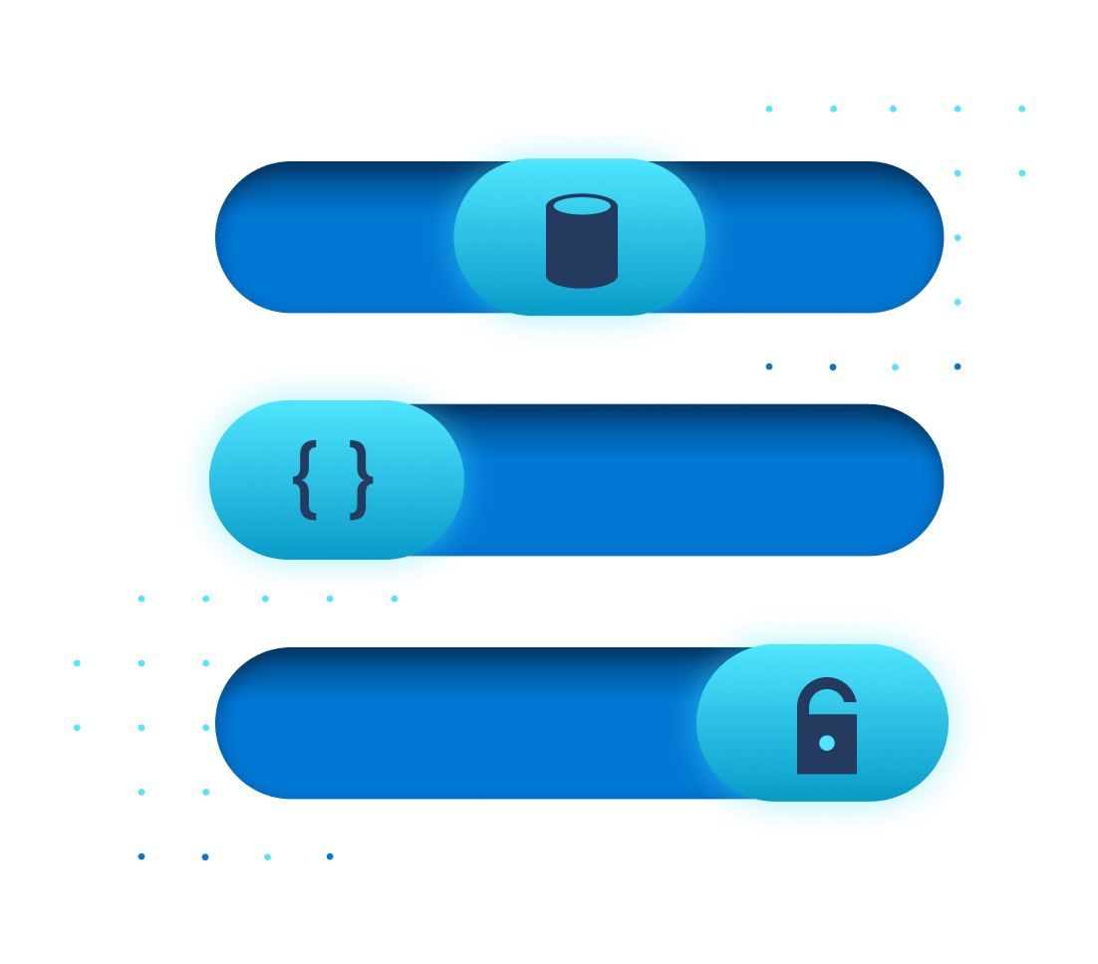
Migration: Test Migration
How do I demarcate a sandbox environment?
By specifying a Virtual Network while starting test migration
Subnet is automatically selected in following priority -
Subnet with same name as the target subnet specified while enabling replication
First subnet available alphabetically that is not a gateway/application gateway/firewall/bastion subnet
What is it?
Creates test copies of replicating servers in an Azure sandbox environment
Intended to help validate server and app functionality
Non-disruptive to source server and ongoing replication
Can be performed multiple times once Initial Replication is completed
Notes:
For more info on -
Test Migrations

Slide 85



Migration: Using ExpressRoute Microsoft peering
For agentless and agent-based migrations
Data plane (replication data) can be routed through ExpressRoute with Microsoft Peering for better bandwidth or latency requirements.
Control plane (replication orchestration) communications happen over the Internet.
For replication data transfer over Microsoft peering, configure route filters to advertise routes for the Azure Storage endpoints. This would be the regional BGP communities for the target Azure region (region for migration).
To route control plane traffic over Microsoft peering, configure route filters to advertise routes for other public endpoints as required.
.*.vault.azure.net
.*.servicebus.windows.net
.*.discoverysrv.windowsazure.com
.*.migration.windowsazure.com
.*.hypervrecoverymanager.windowsazure.com
.*.backup.windowsazure.com
Replication appliance
(agent-based)
Hyper-V Replication Provider
Azure Migrate appliance - VMware
On-premises environment
Azure Migrate
Azure Storage
Azure Compute
Orchestration data (over Internet and ExpressRoute with Microsoft peering)
Replication data (over ExpressRoute with Microsoft peering)
Connectivity to Azure VM post failover (over Internet or ExpressRoute Private)

Slide 86
Migration: Using ExpressRoute Microsoft peering
For agentless and agent-based migrations
Internet connectivity:
You still need internet connectivity from the on-premises site for other URLs that aren't reachable over ExpressRoute Microsoft peering.
Following URLs require Internet connectivity: *.portal.azure.com, *.windows.net, *.msftauth.net, *.msauth.net, *.microsoft.com, *.live.com, *.office.com, *.microsoftonline.com, *.microsoftonline-p.com, *.microsoftazuread-sso.com, management.azure.com, *.services.visualstudio.com (optional), aka.ms/* (optional), download.microsoft.com/download
Proxy configuration:
If the appliance uses a proxy for internet connectivity, you may need to configure proxy bypass for certain URLs to route them via the Microsoft peering circuit. For replication traffic, you can configure a proxy bypass rule for “.*.blob.core.windows.net”.
Azure Migrate project configuration:
The Azure Migrate project should be configured for public connectivity (should not be configured with private endpoint).
Replication appliance
(agent-based)
Hyper-V Replication Provider
Azure Migrate appliance - VMware
On-premises environment
Azure Migrate
Azure Storage
Azure Compute
Orchestration data (over Internet and ExpressRoute with Microsoft peering)
Replication data (over ExpressRoute with Microsoft Peering)
Connectivity to Azure VM post failover (over Internet or ExpressRoute Private)

Slide 87

Migration: Using ExpressRoute private peering
For agentless VMware migrations
Data plane (replication data) can be routed through a private network and ExpressRoute private peering circuits.
Control plane (replication orchestration) communication must happen over the Internet or ExpressRoute Microsoft peering (only for agentless VMware migrations).
To replicate over a private network, create and attach a private endpoint to the cache storage account to connect to the storage account and transfer data over a private link.
Note:
Proxy configuration:
For proxy bypass, customers can add a proxy bypass rule for the cache storage account (<storageaccountname>.blob.core.windows.net).
Azure Migrate project configuration:
The Azure Migrate project can be configured for public or private connectivity.
Azure Migrate appliance - VMware
On-premises environment
Azure Migrate
Azure Storage
Azure Compute
Orchestration data (over Internet)
Replication data (over ExpressRoute with private peering)
Connectivity to Azure VM post failover (over ExpressRoute with private peering)
Notes:
Learn more - Replicate data over ExpressRoute with Azure Migrate Server Migration - Azure Migrate | Microsoft Docs

Slide 88
Migration: Using ExpressRoute private peering
For agentless Hyper-V and agent-based migrations
Data plane (replication data) and control plane (replication orchestration) can be routed through ExpressRoute private peering or VPN connections using Azure Migrate Private Link support.
Note:
URL access:
You will need access to the following URLs over and above private link access:
*.blob.core.windows.com
https://management.azure.com
https://login.microsoftonline.com
https://login.windows.net
https://www.live.com and
https://www.microsoft.com
Azure Migrate project configuration:
The Azure Migrate project should be configured for private connectivity (should not be configured with public endpoint).
Replication appliance
(agent-based)
Hyper-V Replication Provider
On-premises environment
Azure Migrate
Azure Storage
Azure Compute
Replication data (over ExpressRoute with private peering)
Connectivity to Azure VM post failover (over ExpressRoute with private peering)
Notes:
Using Azure Migrate with private endpoints - Azure Migrate | Microsoft Docs

Slide 89
Azure Migrate Private Link Support

Slide 90
Question 01: What is Private Link? Question 02: What about DNS integration? Question 03: What about UDR support?

Slide 91


Private Link: Capabilities
Execute faster
Leverage existing ExpressRoute private peering circuits for migrations at-scale
Be compliant
Adhere to organizational policies and requirements to not traverse public endpoints
Be secure
Achieve network isolation and guard against data exfiltration risks
Onboard easily
Leverage simplified E2E experience that abstracts underlying configuration complexity
Notes:
For more info on –
Azure Migrate appliance overview
Appliance deployment options

Slide 92
Private Link: Supported scenarios
Discovery and assessment
Migration
End to end support for
Discovery and assessment of VMware VMs, Hyper-V VMs, physical servers, VMs running on GCP/AWS, or VMs running on a different virtualization provider
Discovery of applications and roles on VMware VMs
Agentless dependency analysis of VMware VMs
End to end support for
Agentless Hyper-V migrations
Agent-based migrations of VMware VMs, Hyper-V VMs, physical servers, VMs running on GCP/AWS, or VMs running on a different virtualization provider
Note -
Agent-based dependency visualization requires Internet connectivity, either directly or via proxy.
Note -
Agentless VMware migrations require Internet access or connectivity via ExpressRoute Microsoft peering
Notes:
Get started:
Discover, assess, and migrate servers over a private network using Azure Private Link. - Using Azure Migrate with private endpoints - Azure Migrate | Microsoft Docs.
Replicate data over ExpressRoute with Azure Migrate: Server Migration - Replicate data over ExpressRoute with Azure Migrate Server Migration - Azure Migrate | Microsoft Docs
Troubleshoot network connectivity issues using Azure Migrate with private endpoints – Troubleshoot network connectivity issues - Azure Migrate | Microsoft Docs
Additional DNS settings may be required to establish private endpoint connectivity. Learn more - Azure Private Endpoint DNS configuration | Microsoft Docs

Slide 93


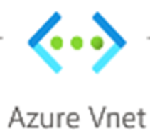

Private Link: Discovery and assessment architecture
For all scenarios
Azure Migrate appliance
Assessments
Application inventory
Private endpoints
ExpressRoute private peering / S2S VPN
ESXi host/ Hyper-V host/ physical server
Azure Migrate
Discovered servers
Agentless Dependency
*Additional DNS settings may be required to establish private endpoint connectivity.
Notes:
For more info on -
Agentless VMware migration architecture

Slide 94


Private Link: Migration architecture
For agentless Hyper-V and agent-based migrations
Azure Migrate
Hyper-V replication provider/ Replication appliance
Replication orchestration
Replication orchestration
ExpressRoute private peering / S2S VPN
Data transfer to managed disks
Hyper-V host/ Physical Server
Private endpoint
Cache/Replication Storage Account
Private endpoint
Recovery Services Vault
*Additional DNS settings may be required to establish private endpoint connectivity.
Notes:
For more info on DNS configuration Azure Private Endpoint DNS configuration | Microsoft Docs

Slide 95
Private Link: Additional permissions required
Operation | Permissions
Create and manage private endpoints | Microsoft.Network/privateEndpoint/write/action Microsoft.Network/privateEndpoint/read/action
Attach a private endpoint to a virtual network or subnet | Microsoft.Network/virtualNetworks/subnet/join/action Microsoft.Network/virtualNetworks/join/action
Link the private endpoint to an ARM resource (vault, storage, key-vault etc.) | Microsoft.[RP]/[resouceName]/privateEndpointConnectionApproval/action Microsoft.[RP]/[resouceName]/privateEndpointConnections/read
Create a network interface and join to a network security group | Microsoft.Network/networkInterfaces/read Microsoft.Network/networkInterfaces/subnets/write Microsoft.Network/networkInterfaces/subnets/read Microsoft.Network/networkSecurityGroups/join/action (optional)
To assign RBAC to another user or Managed Identity on an ARM resource | Microsoft.Authorization/roleAssignments/write

Slide 96
Containerize ASP.NET and Java web apps and migrate to Azure Kubernetes Service (AKS)

Slide 97

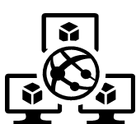
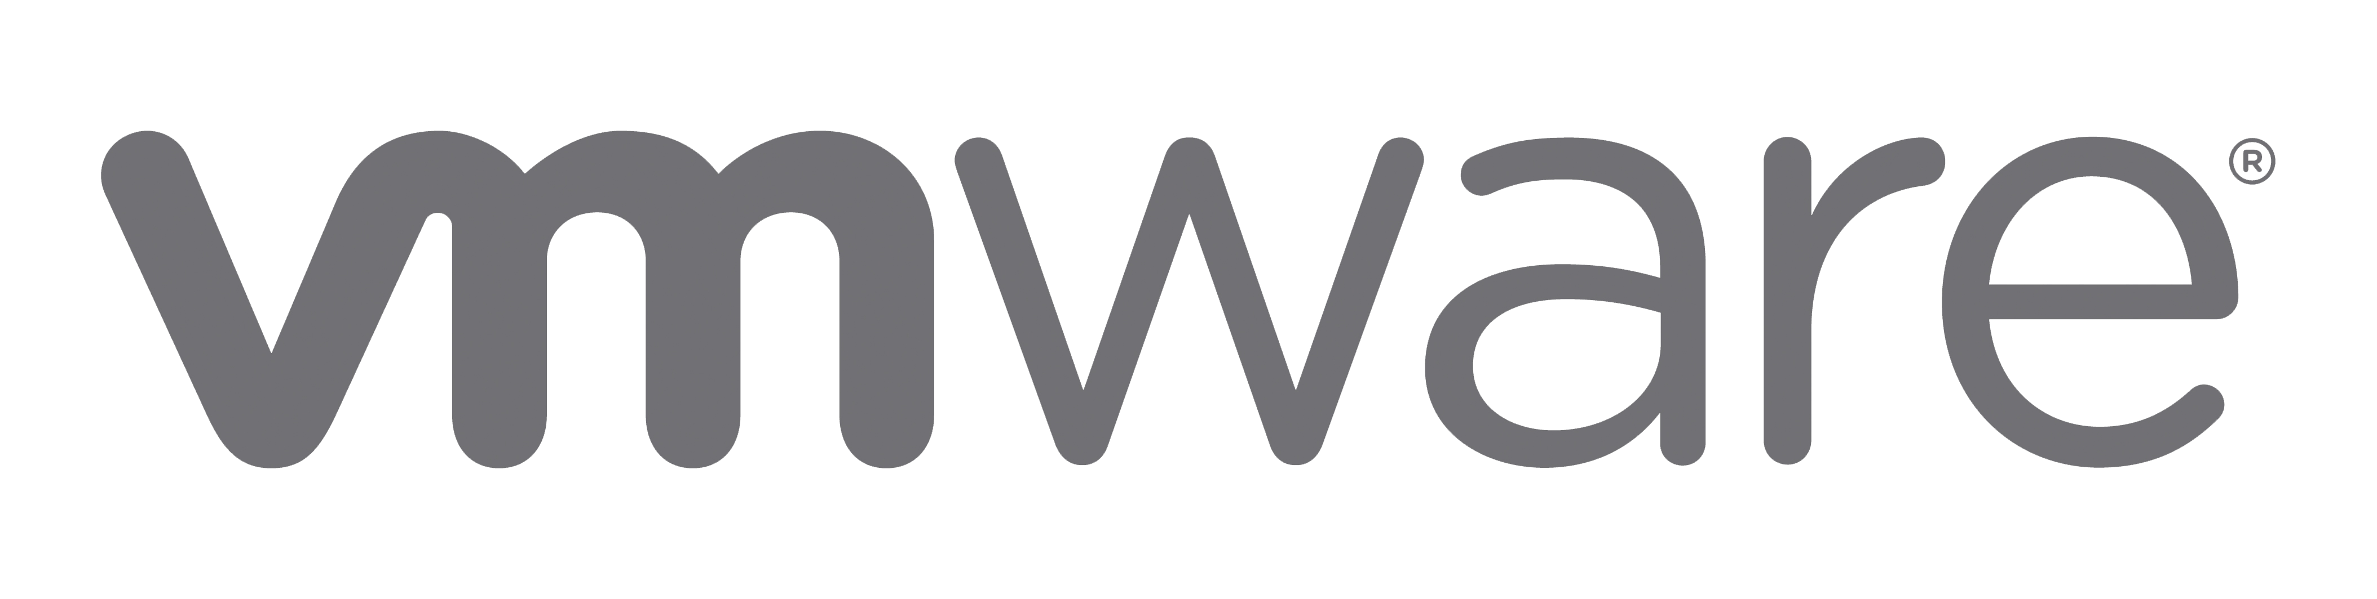

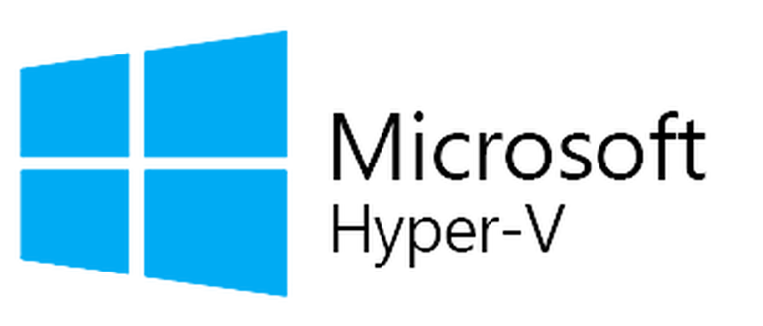
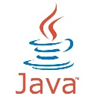

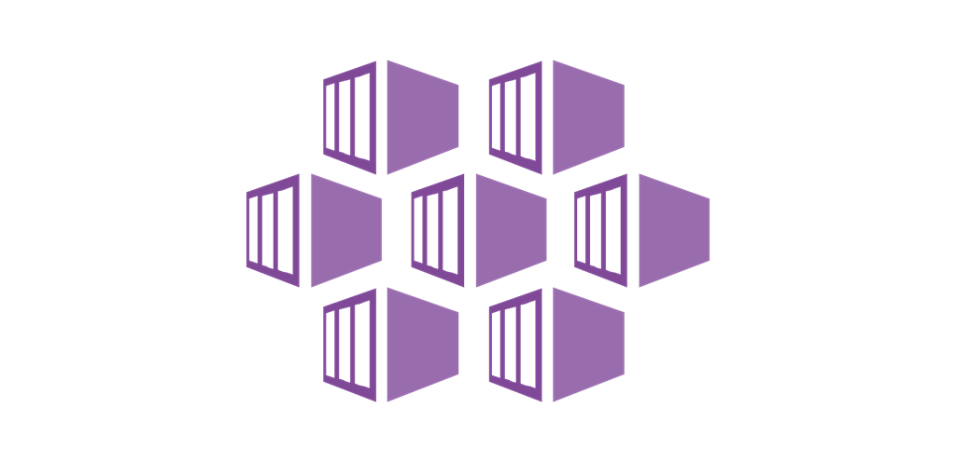
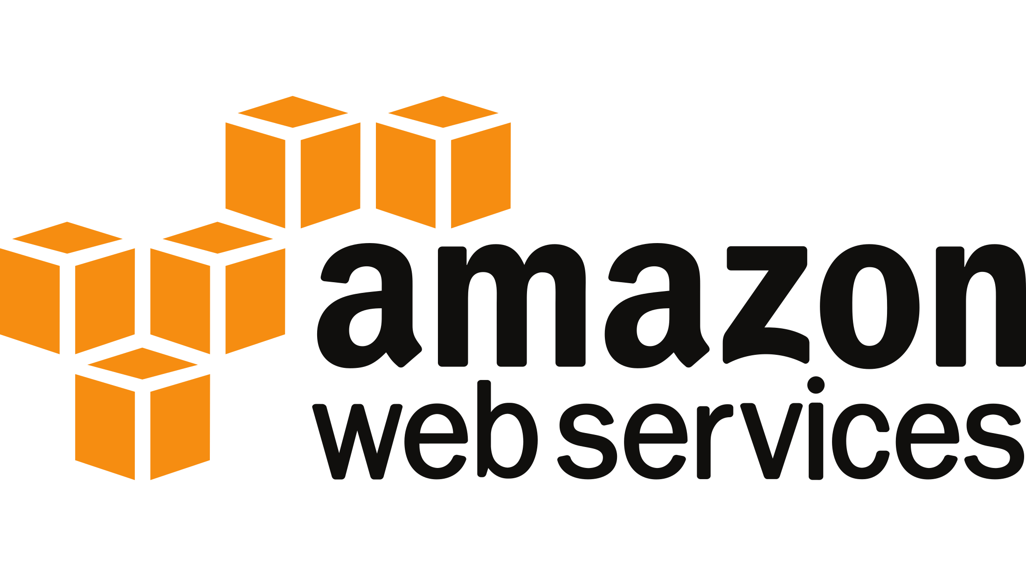
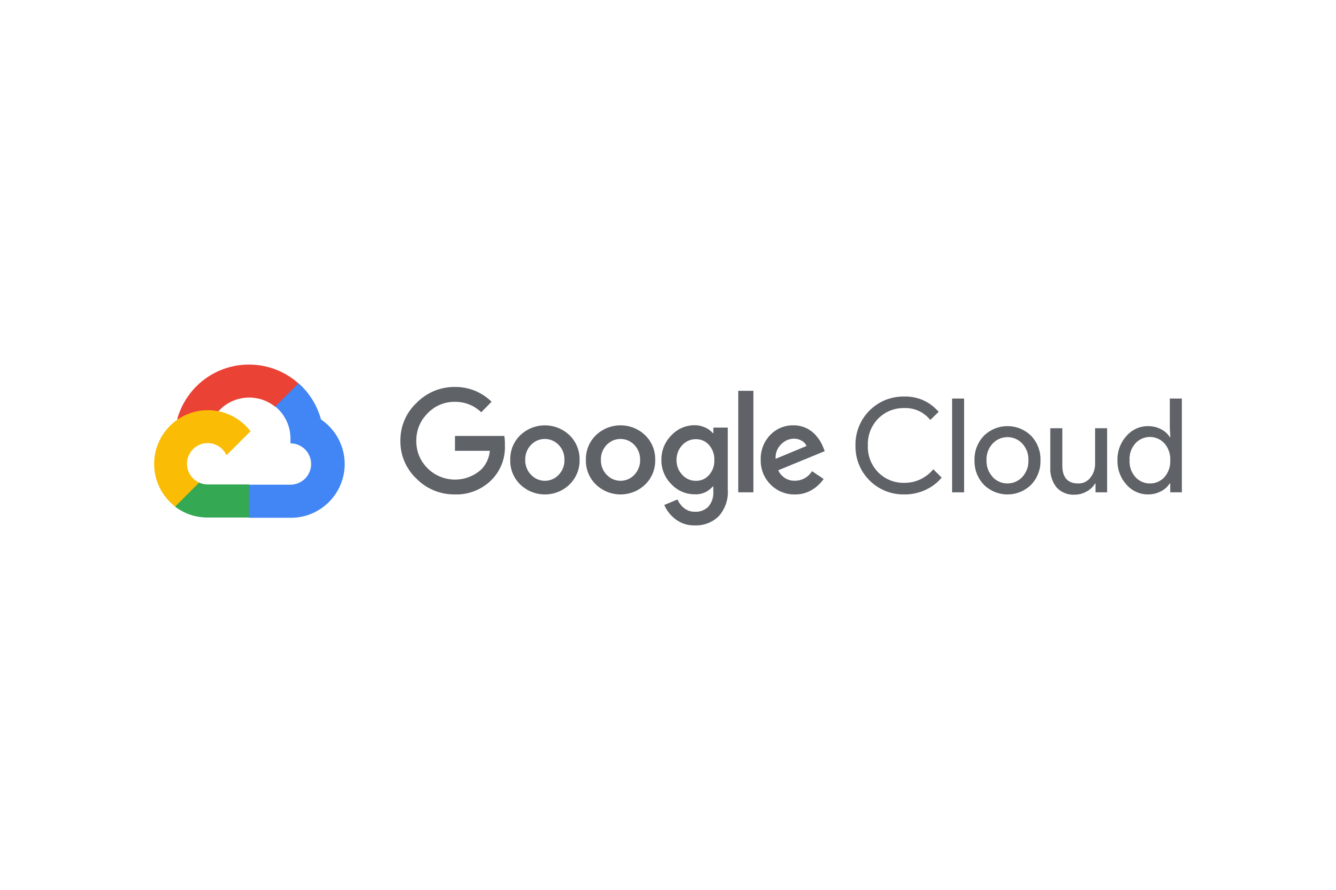
App migration: Options
LOB application web and app tier (ASP.NET/Java web apps)
Azure Migrate Server migration
Azure laaS
Azure Migrate Web app migration
App Service
Azure Migrate App containerization
AKS

Slide 98




App Containerization: Capabilities
Containerize and migrate your apps to AKS
Point and Containerize
Parameterize configurations
Reusable artifacts
Customization
Convert apps to container images with minimal to no code changes
Parameterize application configurations such as connection strings
Download generated artifacts Dockerfiles, Kubernetes manifests
Ability to customize at every step of the way

Slide 99

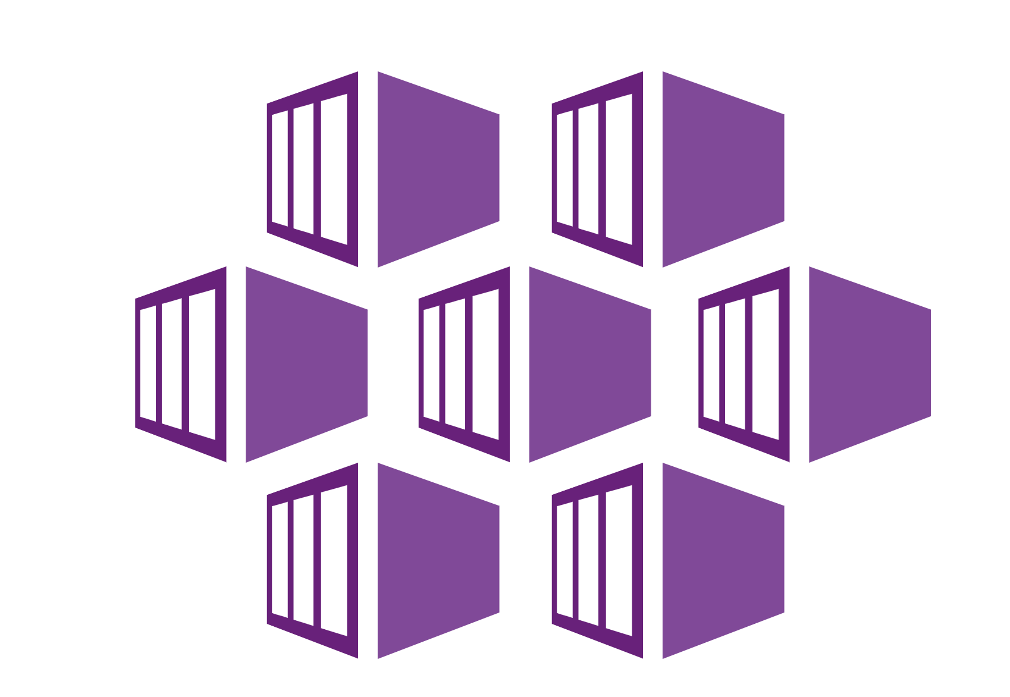
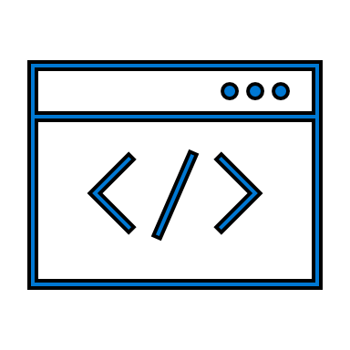
App Containerization: Process
Download and install the Azure Migrate: App Containerization tool on any Windows machine
Tool remotely connects to app servers to discover apps and their configurations. Provides option to parameterize connection strings and use persistent volumes
Build container image and publish the image to Azure Container Registry
Deploy containerized app to AKS
Notes:
For more info on -
VMware discovery tutorial
Hyper-V discovery tutorial
Physical server discovery tutorial

Slide 100
App Containerization: Supported versions & pre-requisites
ASP.NET
Java web apps
App requirements
Microsoft .NET framework
version 3.5 or later
Internet Information Services (IIS)
version 7.5 or later
App server requirements
Microsoft Web deploy tool installed
PowerShell remoting enabled
Local/domain administrator account
App requirements
Apache Tomcat
version 8.0 or later
Java Development Kit
version 7.0 or later
App server requirements
SSH remoting enabled
Root account
Supported VMs
Windows Server 2008 R2 and above
Supported VMs
Ubuntu Linux 16.04/18.04/20.04
Debian 7/8
CentOS 6/7
Red Hat Enterprise Linux 5/6/7.
Notes:
For more info on -
VMware discovery support
Hyper-V discovery support
Physical server discovery support

Slide 101
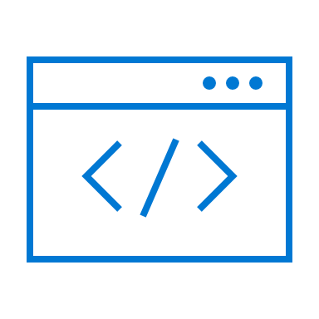



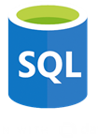

App Containerization: Architecture
LOB App
Azure Container Registry
App containerization helper
AKS Cluster
Web layer
Dockerfile
Create ACR/AKS cluster
Container image
Kubernetes yaml specs
Use Persistent Volumes
Pod
Pod
Publish image
Deploy to AKS
Parameterized configuration
DB
Data layer
DB
PV through Azure File Share
DB migration or test copy

Slide 102
But my customer has this scenario…

Slide 103

Customer Scenario - VMware
Glasgow Datacentre
Edinburgh Datacentre
Dundee Datacentre
Aberdeen Datacentre
Inverness Datacentre
vCenter server
vCenter server
vCenter server
vCenter server
vCenter server
5 different datacentres, 5 different vCenter servers
What should my Azure Migrate architecture look like?

Slide 104
Customer Scenario – VMware answer
Customer Scenario - VMware
Azure Migrate Project
Glasgow Datacentre
Edinburgh Datacentre
Dundee Datacentre
Aberdeen Datacentre
Inverness Datacentre
vCenter server
vCenter server
vCenter server
vCenter server
vCenter server
Notes:
For each vCenter Server, you need to deploy one Azure Migrate appliance. Therefore, you need to deploy five appliances.
All five appliances can be part of one project in this case. We usually don’t recommend deploying multiple appliances in one project, but in this case it will work. This is because there will not be overlapped discovery as appliance will discover VMs from different datacenters. Learn more.
You can replicate VMs discovered from one appliance to exactly one region, locked at the time of first replication. So, five different appliances can be used to migrate to five different regions.
A good mental model to think about it is:
Start from one vCenter Server
Number of appliances will be equal to the number of regions you want to replicate the VMs to
Number of projects will be equal to the number of appliances
Replicate the same for n number of vCenter Servers

Slide 105

Customer Scenario – older servers

Slide 106
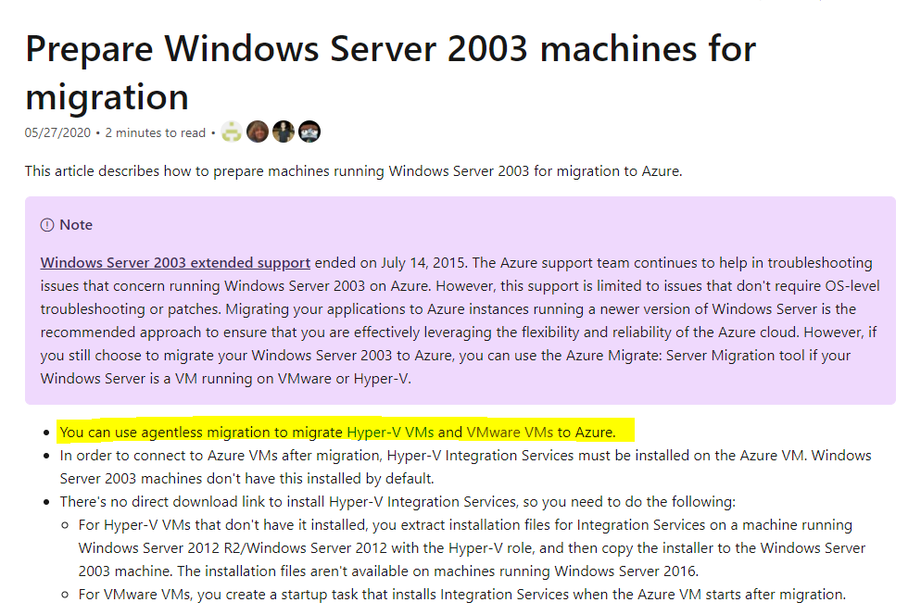
Customer Scenario – older servers answer
Customer Scenario – older servers
Notes:
Agentless migration is supported.
For discovery, think of them as physical servers or look to the CSV import to bring the details into Azure Migrate.

Slide 107

Customer Question
Azure Migrate
or
Azure Site Recovery

Slide 108
Migration: Overview
Azure Migrate: Server migration vs Azure Site Recovery
 | Azure Migrate: Server migration | Azure Site Recovery
Scenario | Purpose-built for server migration to Azure | Built for disaster recovery (DR) for servers
Options | Agentless for VMware & Hyper-V Agent-based | Agent-based (migrating with DR constructs)
Pricing | Free tooling (migrate within 180 days per machine) Pay for only storage and network Compute charges for test migration | Free tooling for 31 days (charges per server instance)
Feature support | Integrated end-to-end journey tracking Carry forward assessments for migration Migration centric features (custom resource naming, tagging, automatic Azure VM agent install etc.) | Disaster recovery-centric features
Recommended use | Migration to Azure | Disaster recovery of Azure VMs and for hybrid disaster recovery scenarios
Pricing | Free | Free for first 180 days
Both tools share certain components. Recovery Services vault is used by Azure Migrate: Server Migration, Disaster Recovery, and Azure Backup.
Common components are used for replication in the Hyper-V and agent-based replication scenarios.
Notes:
For more info on -
Azure Migrate overview

Slide 109
Customer Question
Site Recovery

Slide 110
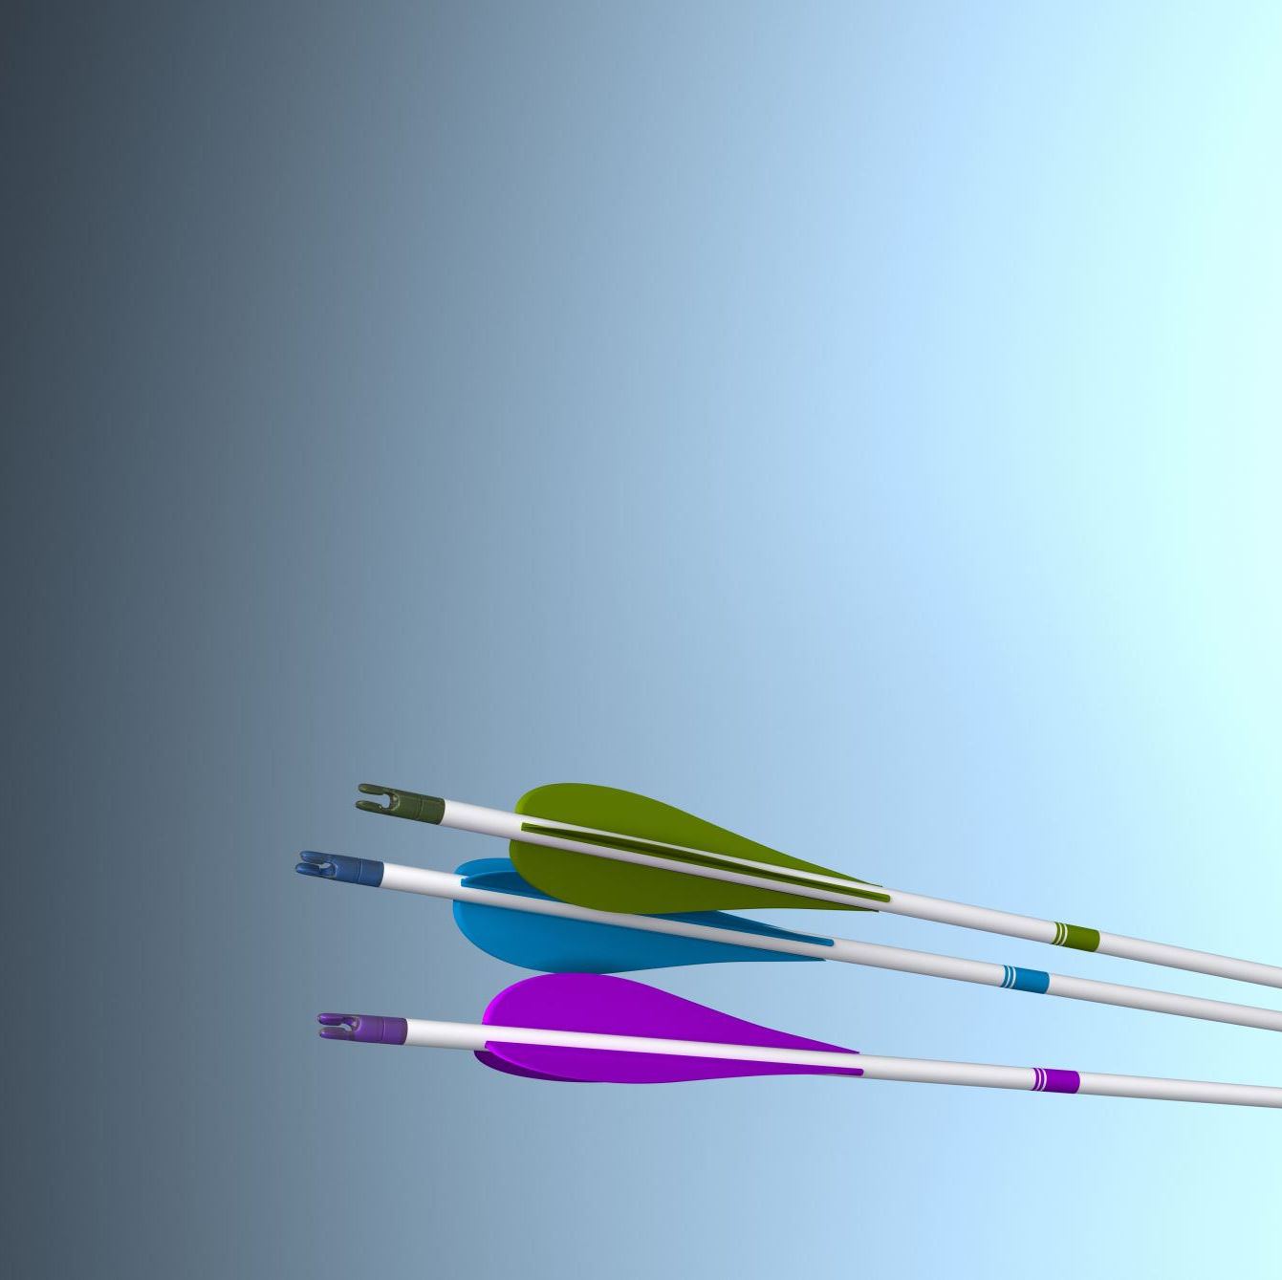
General Tips

Slide 111
Good Practice
Use Azure Migrate as single point of glass
Collect as much as possible using Azure Migrate native
Add 3rd party collections if needed in specific cases only
Use PowerBI to visualize the Azure Assessment Migrate results
Azure Migrate is in 95% the way to do the migration
Add 3rd party collections if needed in specific cases only

Slide 112
Learn from my mistakes…
Make sure your Azure Migrate appliance has the right time/date/time zone
Reboot the source VMs before migration to clear any pending reboots, issues
Test migrations to a temporary or restricted network area (add ref. to DC)
Consider implementing networking throttling
Create a temporary resource group for your Azure Migrate project
Use Azure Lighthouse for at-scale migrations
Notes:
Correct date and time can help avoid some trivial issues you might encounter
Rebooting your source vms before you start to migrate also avoids issues again
Test your migrations in a restricted area, make sure access to production environments are restricted unless you want that kind of testing in production.
When replicating traffic to azure look at networking throttling, the migrate appliance has various methods of doing that but maybe the network team could do something as well, try not to bring down the network with replication traffic
And when you are creating your migrate project don’t put it in a production resource group, put it in one that can be easily deleted once your migration project is finished. Making sure you clean up behind you.

Slide 113

Azure Migrate resources
Learn more aka.ms/AzureMigrate​
Documentation aka.ms/AzureMigrateDocs​
Azure Migration Blog aka.ms/MigrationBlogs
Azure Migrate Demos aka.ms/AzureMigrateGettingStarted
E-Book
aka.ms/AzureMigrateEbook
Learning path
aka.ms/AzureMigrateLearning

Slide 114
Thank you.

